Slide 1
The 8 T’s of Grateful Living POWERPOINT INSTRUCTIONS (Delete this slide before presenting! ☺)
All the work is done! ☺
These slides are simply a helpful guide to get you started on the 8 T’s of Grateful Living theme. You can add, delete or edit them to suit your personal message.
REMEMBER to download the correct Sermon Script (it’s editable too), from the Grateful Living website, because it gives a suggested script for each slide.
To insert a New Slide. Select New Slide or Layout and select from the 25 x slide templates.* Then simply insert your own text and images onto the slides.
*If you would like to edit the 25 Master templates or make additional slide templates you will need to do the following: Select View > Master > Slide Master.
You can then duplicate a slide layout and make the changes you want.
When you're done, simply select Close Master View.

Slide 2
Why should we encourage Grateful Living? (Delete this slide before presenting! ☺)
Because an ‘attitude of gratitude’ is good for us, and it’s God will! (1 Thess. 5:16-18; Prov. 17:22; Eph. 5:20; 2 Cor. 4:15)
This series of Grateful Living messages falls under the category of what we often call ‘stewardship’—managing the things that God gives us—but for many listeners these messages will open up a whole new way of living abundantly (John 10:10).
You see, it’s simple, yet profound. God is love, and because he loves he gives (see John 3:16). God calls us to be faithful stewards of His love by loving Him and giving His love to others. We do this by sharing all that we have and are.
The very heart and foundation of stewardship isn’t money, it’s love.
At it’s very essence, Faithful Stewardship = Loving God and people with all we have and all we are. We are to love God and people with everything, with our 8 T’s—Time, Talents Testimony, Temple, Treasure, Territory, Tribe and God’s Truth.
In the book Counsels on Stewardship by Ellen G. White, the word ‘love’ is used 36 times in just the first 18 pages! Love is the foundation of stewardship.
When we understand God’s love we live gratefully. Grateful Living is about whole-of-life giving. God gives to us so that we can give to others. “And God is able to make all grace abound to you, so that in all things at all times having all that you need you will abound in every good work.” (2 Corinthians 9:8)
The gospel calls for a whole new way of living, grateful living, and it places love at the centre. When we love like God loves, “when we love the world as He has loved it, then for us His mission is accomplished. We are fitted for heaven; for we have heaven in our hearts.” (Ellen G. White, The Desire of Ages, p. 641)
So, is this 8 Pillars of Grateful Living really a stewardship series? Yes, because grateful living leads to cheerful giving, not only more faithful tithing and generous, systematic offerings, but whole-of-life giving, and that’s what God invites us to experience.
Welcome! to a whole new level of Christ-centred abundant living.

Slide 3
Grateful Living Topic: TERRITORY Message Overview (Delete this slide before presenting! ☺)
Key Scriptures: Genesis 1:26 & 2:15; Jeremiah 2:7, Isaiah 24:4-6
Key EGW Writings: See overview article ‘Ellen White and the Environment’ at https://www.adventistworld.org/ellen-white-and-the-environment/
Goal: Faithfully caring for my land and the environment.
Interview Idea: Is there an inspiring person in your church or wider community who you can interview (maybe even by phone or Zoom) about the importance of caring for their land and wider environment?

Slide 4
The slides for the actual presentation start on slide #5. (Delete this slide before presenting! ☺)

Slide 6
The 2-minute video called
Grateful Living Introduction
can be inserted and/or shown here.
The video can be downloaded at https://stewardship.adventistchurch.com/grateful-living/
Or simply delete this slide if you’re not showing the video.

Slide 11
Possible opening illustration (Delete this page before presenting! ☺)
The howls of wolves were unmistakable. The moon was full, and the pack was on the prowl. Inside a sparsely furnished cabin a small group of researchers huddled anxiously in a corner. Strangely, they weren’t at all concerned about the hunt outside. Instead, their attention was focused on a computer screen displaying results from years of painstaking research. The story told by the graphs and statistics was as riveting as the howls that pierced the night air.
These researchers were studying the Yellowstone National Park ecosystem in the United States, where wolves were reintroduced in 1995 after being killed off nearly 70 years prior. Remarkably, the findings suggested that the presence or absence of just one species—the wolf—could potentially affect an entire ecosystem. ¹
Shortly after the wolf was restored, the elk that the wolves hunted changed their behaviour and moved away from their favourite grazing areas. The aspen forests and streamside vegetation began to grow again when the saplings were no longer consumed by the elk. Next, amphibians, reptiles, beavers, and songbirds staged impressive comebacks as vegetation increased. Tree roots stabilized the stream banks and reduced erosion. Beaver activities raised the water table. Thus, the wolf’s presence in Yellowstone appeared not only to improve the ecology and richness of the ecosystem dramatically, but indirectly changed its physical geography as well!
So what have we learned from Yellowstone’s wolves? Complex relationships exist among plants, animals, and their abiotic environment. By altering just one component, we often change that environment in unforeseen ways. The lesson is clear: we should reflect carefully on how we treat creation.
The wolf is a fitting icon of humankind’s relationship to nature. Our need to subjugate nature and tame it to our liking is typified by the expression “the only good wolf is a dead wolf.” Early Americans declared war on the wolf, and sought to exterminate it with bounties that resulted in the deaths of millions of wolves.
Today the tables have turned dramatically. As Americans have become more environmentally conscious, wolf preservation has become a rallying cry. Nevertheless, some continue to deplore the policies that maintain the wolf’s existence in Yellowstone. Through no fault of its own, the once-feared shaggy canine has found itself at the centre of a controversy between those who support and those who oppose hands-on creation care.
Source ‘​Christians and Environmental Stewardship: Creation care or crying wolf?’ by William K. Hayes. Read the full article at https://www.adventistreview.org/1601-45
Watch a related video about the wolves of Yellowstone at https://www.youtube.com/watch?v=ysa5OBhXz-Q

Slide 12
“For all creation is waiting eagerly for that future day when God will reveal who his children really are. Against its will, all creation was subjected to God’s curse. But with eager hope, the creation looks forward to the day when it will join God’s children in glorious freedom from death and decay. For we know that all creation has been groaning as in the pains of childbirth right up to the present time.”
Romans 8:19-22 (NLT)

Slide 13

God’s Blueprint
Satan’s Counterfeit
The earth is God’s, and He invites us to carefully manage it and protect it.
My land is God’s, and I am committed to using it for His glory.
God wants to bless me with a long life on the land that He has given me.
I will protect the environment from things that will pollute and damage it.
The earth is just a result of random evolution, so do what you want to it.
God has no say or jurisdiction over how I use my land.
The earth is only here to be exploited by humans to make money.
The earth is going to burn soon so there’s no need to care for it.

Slide 14

God invites us to be faithful stewards and managers of all that He entrusts to us. When we understand that God owns everything, our ‘ownership’ ends, and ‘stewardship’ begins.

Slide 15

“Then God said, “Let Us make man in Our image, according to Our likeness; let them have dominion over the fish of the sea, over the birds of the air, and over the cattle, over all the earth and over every creeping thing that creeps on the earth.””
Genesis 1:26 (NKJV)

Slide 16

“Then the Lord God took the man and put him in the garden of Eden to tend and keep it.”
Genesis 2:15 (NKJV)

Slide 17
Ethiopia’s forests nearly all destroyed in the 20th century. Today there are around 35,000 tiny islands of green forest in the dry, barren landscape, most of them with churches at the centre. Some of them are just two hectares, while others are up to 400 hectares.

Slide 18
Why are the forests preserved primarily around churches? Because the churches know it is their responsibility to preserve the forests, like mini Edens.
“Symbolizing the Garden of Eden … , the woods are revered as places of worship to be cared for and cherished but are not considered to be living deities.”
Lita Cosner, Creation Magazine,
2019 Volume 41, Issue 3

Slide 19
“I brought you into a bountiful country, to eat its fruit and its goodness. But when you entered, you defiled My land and made My heritage an abomination.”
Jeremiah 2:7 (NKJV)

Slide 20
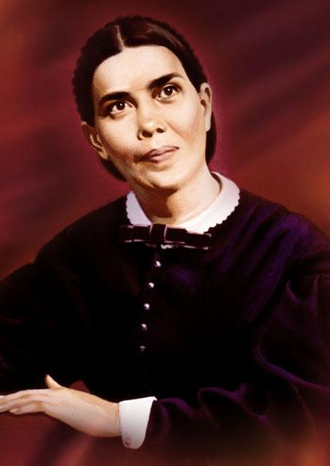
“Human beings were to cooperate with God in restoring the diseased land to health, that it might be a praise and a glory to His name. … The earth is the Lord's vineyard, and is to be treated according to His plan.”
Ellen G. White
SDA Bible Commentary, Vol. 1, 1112

Slide 21
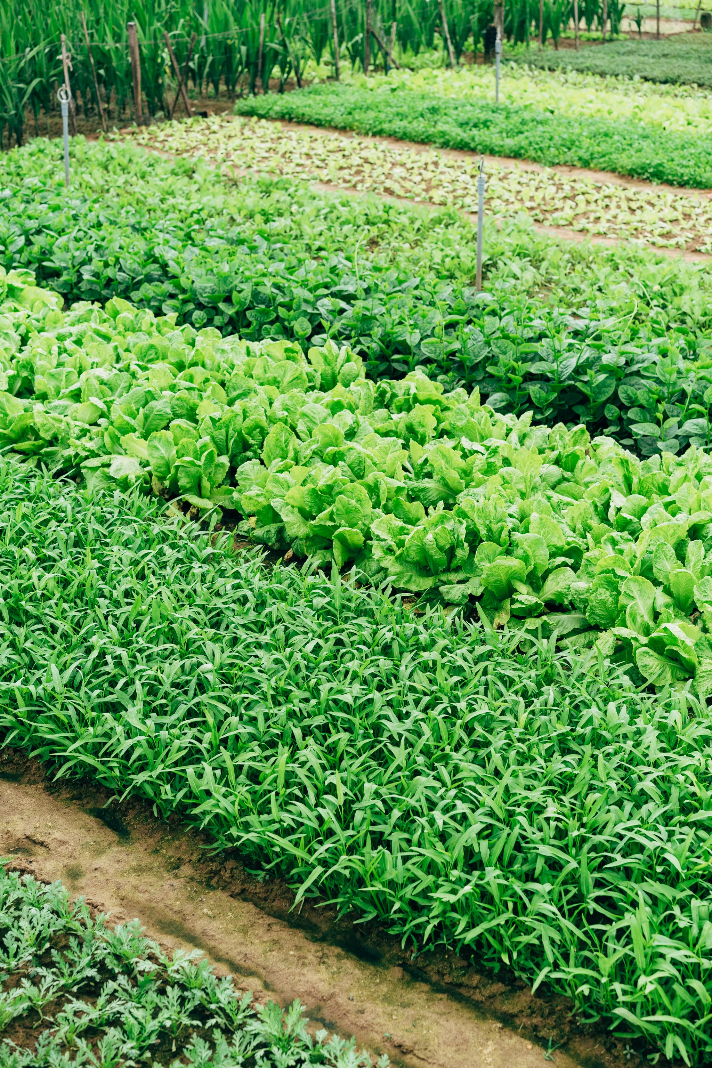
“Those who cultivated the soil were to realize that they were doing God service. They were as truly in their lot and place as were the men appointed to minister in the priesthood and in work connected with the tabernacle.”
Ellen G. White
SDA Bible Commentary, Vol. 1, 1112

Slide 22
“The home of our first parents … beautified by the hand of God Himself, was not a gorgeous palace. Men, in their pride, delight in magnificent and costly edifices and glory in the works of their own hands; but God placed Adam in a garden. This was his dwelling. … In the surroundings of the holy pair was a lesson for all time—that true happiness is found, not in the indulgence of pride and luxury, but in communion with God through His created works. … To the dwellers in Eden was committed the care of the garden, “to dress it and to keep it.””
Ellen G. White, Patriarchs & Prophets, 49-50

Slide 23
“The earth dries up and withers, the world languishes and withers, the heavens languish with the earth. The earth is defiled by its people; they have disobeyed the laws, violated the statutes and broken the everlasting covenant. Therefore a curse consumes the earth; its people must bear their guilt.”
Isaiah 24:4-6 (NIV)

Slide 24
“The nations were angry, and Your wrath has come, and the time of the dead, that they should be judged, and that You should reward Your servants the prophets and the saints, and those who fear Your name, small and great, and should destroy those who destroy the earth.”
Revelation 11:18 (NKJV)

Slide 25
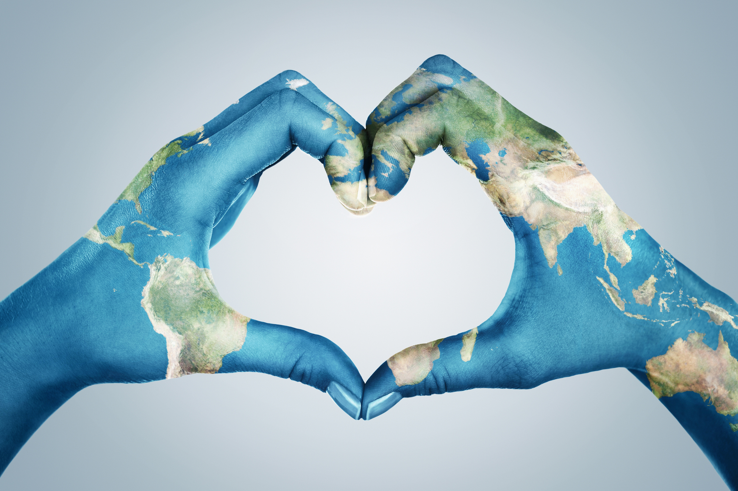

Adventists & the Environment
“The world in which we live is a gift of love from the Creator God, from “Him who made the heavens, the earth, the sea, and the springs of water” (Revelation 14:7; 11:17, 18). Within this creation He placed humans, set intentionally in relationship with Himself, other persons, and the surrounding world. Therefore, as Seventh-day Adventists, we hold its preservation and nurture to be intimately related to our service to Him.”
General Conference of Seventh-day Adventists
Executive Committee, October 12, 1992

Slide 26
Adventists & the Environment
“The ecological crisis is rooted in humankind’s greed and refusal to practice good and faithful stewardship within the divine boundaries of creation.
Seventh-day Adventists advocate a simple, wholesome lifestyle, where people do not step on the treadmill of unbridled consumerism, goods-getting, and production of waste. We call for respect of creation, restraint in the use of the world’s resources, reevaluation of one’s needs, and reaffirmation of the dignity of created life.”
General Conference of Seventh-day Adventists Administrative Committee, 1995

Slide 27
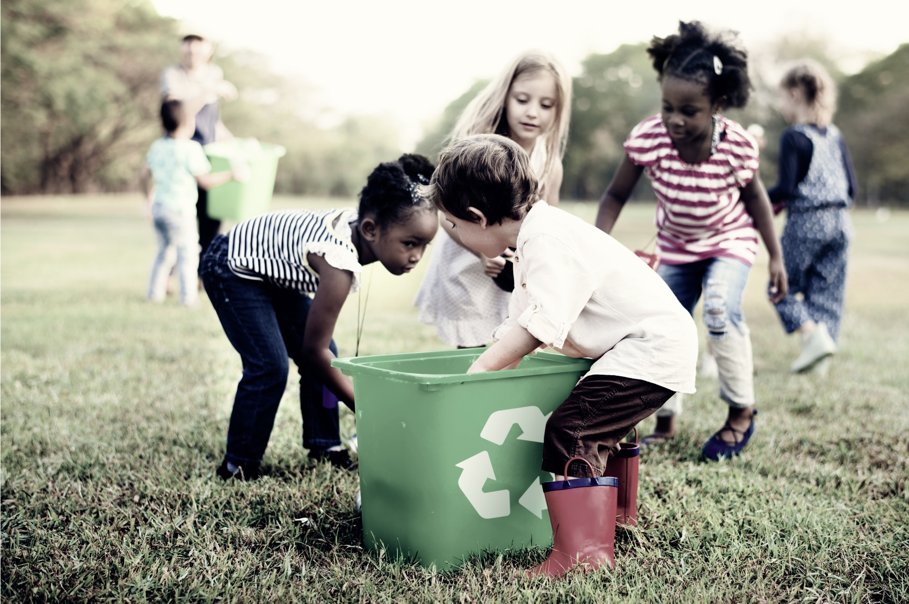
Q. How to be faithful with my Territory?
A. A faithful steward does what their Master would do if He were present.
See Counsels on Stewardship, p. 113

Slide 28
