Slide 1
The 8 T’s of Grateful Living POWERPOINT INSTRUCTIONS (Delete this slide before presenting! ☺)
All the work is done! ☺
These slides are simply a helpful guide to get you started on the 8 T’s of Grateful Living theme. You can add, delete or edit them to suit your personal message.
REMEMBER to download the correct Sermon Script (it’s editable too), from the Grateful Living website, because it gives a suggested script for each slide.
To insert a New Slide. Select New Slide or Layout and select from the 25 x slide templates.* Then simply insert your own text and images onto the slides.
*If you would like to edit the 25 Master templates or make additional slide templates you will need to do the following: Select View > Master > Slide Master.
You can then duplicate a slide layout and make the changes you want.
When you're done, simply select Close Master View.

Slide 2
Why should we encourage Grateful Living? (Delete this slide before presenting! ☺)
Because an ‘attitude of gratitude’ is good for us, and it’s God will! (1 Thess. 5:16-18; Prov. 17:22; Eph. 5:20; 2 Cor. 4:15)
This series of Grateful Living messages falls under the category of what we often call ‘stewardship’—managing the things that God gives us—but for many listeners these messages will open up a whole new way of living abundantly (John 10:10).
You see, it’s simple, yet profound. God is love, and because he loves he gives (see John 3:16). God calls us to be faithful stewards of His love by loving Him and giving His love to others. We do this by sharing all that we have and are.
The very heart and foundation of stewardship isn’t money, it’s love.
At it’s very essence, Faithful Stewardship = Loving God and people with all we have and all we are. We are to love God and people with everything, with our 8 T’s—Time, Talents Testimony, Temple, Treasure, Territory, Tribe and God’s Truth.
In the book Counsels on Stewardship by Ellen G. White, the word ‘love’ is used 36 times in just the first 18 pages! Love is the foundation of stewardship.
When we understand God’s love we live gratefully. Grateful Living is about whole-of-life giving. God gives to us so that we can give to others. “And God is able to make all grace abound to you, so that in all things at all times having all that you need you will abound in every good work.” (2 Corinthians 9:8)
The gospel calls for a whole new way of living, grateful living, and it places love at the centre. When we love like God loves, “when we love the world as He has loved it, then for us His mission is accomplished. We are fitted for heaven; for we have heaven in our hearts.” (Ellen G. White, The Desire of Ages, p. 641)
So, is this 8 Pillars of Grateful Living really a stewardship series? Yes, because grateful living leads to cheerful giving, not only more faithful tithing and generous, systematic offerings, but whole-of-life giving, and that’s what God invites us to experience.
Welcome! to a whole new level of Christ-centred abundant living.

Slide 3
Grateful Living Topic: TESTIMONY Message Overview (Delete this slide before presenting! ☺)
Key Scriptures: Acts 4:20; Revelation 12:11; Luke 8:38-39
Key EGW Writings: ‘Our Greatest Need’, Gospel Workers, p. 273-274
Further Reading: ‘Winsome Witnesses’ Sabbath School lesson at https://absg.adventist.org/pdf.php?file=2020:3Q:SE:PDFs:EAQ320_02.pdf
Goal: Faithfully sharing what God has done, and is doing, in my life.
Interview Idea: Is there a person in your church or wider community who can briefly (3-5 minutes) share a portion of their testimony to encourage and inspire the church family?

Slide 4
The slides for the actual presentation start on slide #5. (Delete this slide before presenting! ☺)

Slide 6
The 2-minute video called
Grateful Living Introduction
can be inserted and/or shown here.
The video can be downloaded at https://stewardship.adventistchurch.com/grateful-living/
Or simply delete this slide if you’re not showing the video.

Slide 10

God’s Blueprint
Satan’s Counterfeit
By sharing your testimony, you strengthen the faith of yourself and others.
Your simple, Christ-centred testimony can overcome Satan and his temptations.
Every person can testify to something God has done or is doing in their life.
We should share our testimony at every opportunity.
No-one is interested in your testimony.
If you try and share your testimony at work or school, people will avoid you.
Your testimony isn’t powerful enough to share so don’t bother.
God hasn’t really done anything in your life, it’s all just coincidence.
Go out and live on the wild-side so that you’ll have a cool testimony!

Slide 11
“We cannot stop telling about everything we have seen and heard.”
Acts 4:20 (NKJV)

Slide 12
“No sooner does one come to Christ than there is born in his heart a desire to make known to others what a precious friend he has found in Jesus; the saving and sanctifying truth cannot be shut up in his heart.”
Ellen G. White, Steps to Christ, 78

Slide 13
Now the man from whom the demons had departed begged Him that he might be with Him. But Jesus sent him away, saying, “Return to your own house, and tell what great things God has done for you.” And he went his way and proclaimed throughout the whole city what great things Jesus had done for him.
Luke 8:38-39 (NKJV)

Slide 14
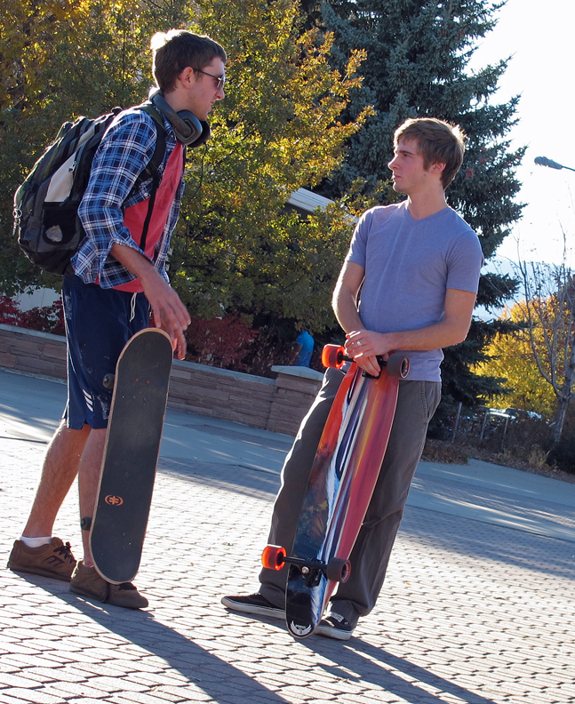
“As witnesses for Christ, we are to tell what we know, what we ourselves have seen and heard and felt. If we have been following Jesus step by step, we shall have something right to the point to tell concerning the way in which He has led us. We can tell how we have tested His promise, and found the promise true. We can bear witness to what we have known of the grace of Christ. This is the witness for which our Lord calls, and for want of which the world is perishing.”
Ellen G. White, The Desire of Ages, 340

Slide 15
And they overcame him [Satan] by the blood of the Lamb and by the word of their testimony.
Revelation 12:11 (NKJV)

Slide 16

“A living Christian will cultivate gratitude of heart. He will seriously, earnestly recount the blessings of his life and the precious results of all his afflictions. He will recall every occasion upon which the hand of Christ has lifted up a standard for him against the enemy. The great love of Jesus, the infinite sacrifice made for man's redemption, will be an unfailing theme for grateful, humble praise.”
Ellen G. White, Review & Herald,
May 30, 1882, par. 8

Slide 17
For He established a testimony in Jacob, … That they should make them known to their children.
Psalm 78:5 (NKJV)

Slide 18
You will be brought before governors and kings for My sake, as a testimony to them and to the Gentiles.
Matthew 10:18 (NKJV)

Slide 19
And I, brethren, when I came to you, did not come with excellence of speech or of wisdom declaring to you the testimony of God.
1 Corinthians 2:1 (NKJV)

Slide 20

“The presentation of Christ in the family, by the fireside, and in small gatherings in private houses is more successful in securing souls to Jesus than are sermons delivered in the open air to the moving throng, or even in halls or churches.”
Ellen G. White, Review & Herald,
December 8, 1885

Slide 21
And this is the testimony: that God has given us eternal life, and this life is in His Son.
1 John 5:11 (NKJV)

Slide 22

“The Saviour knew that no argument, however logical, would melt hard hearts or break through the crust of worldliness and selfishness. He knew that His disciples must receive the heavenly endowment; that the gospel would be effective only as it was proclaimed by hearts made warm and lips made eloquent by a living knowledge of Him who is the way, the truth, and the life.”
Ellen G. White, Acts of the Apostles, 31

Slide 23
God is able to turn
a test into a testimony,
a mess into a message,
a misery into a ministry
and a trial into a triumph!

Slide 24
Keep the fire of your testimony burning so that your children and neighbours and colleagues can warm their hands and hearts on the fire of your faith.

Slide 25
Our testimony must be SPOKEN and LIVED,
one without the other has little impact.

Slide 26

If you’ve been saved,
notify your face!

Slide 27

Q. How to be faithful with my Testimony?
A. A faithful steward does what their Master would do if He were present.
See Counsels on Stewardship, p. 113

Slide 28


