Slide 1


Spiritual Abuse
Photo by Milada Vigerova on Unsplash
Karen Holford – Trans European Division

Slide 2

Introduction
This is a relatively new area – and we are all still learning.
So I welcome your thoughts and ideas as we grow together and learn how to become safe people who create safe families, churches and communities.
Photo by Sandy Millar on Unsplash

Slide 3

Overview
Definition of spiritual abuse.
Unhelpful beliefs that can fuel the abuse.
Forms of spiritual abuse.
The spectrum of behaviour from healthy, unhelpful, unhealthy and abusive, with examples.
How to help those involved in spiritual abuse to move to healthier attitudes and practices.
Being part of the healing process together.
Developing healthy thinking and behaviour.

Slide 4
Spiritual abuse
Abuse: Misuse or maltreatment
Spiritual Abuse: when emotional, physical, social or financial harm or trauma is inflicted in a spiritual context, or by misusing spiritual concepts.
Spiritual abuse can also occur through psychological manipulation of a person by using the teachings of their religion.
The perpetrators are usually people of the same faith, and they are often in a position of power within the spiritual community or family.

Slide 5
Spiritual abuse
Oakley & Kinmond, 2013 p21:
Spiritual abuse is coercion and control of one individual by another in a spiritual context. The target (victim) experiences spiritual abuse as a deeply emotional personal attack.

Slide 6
Spiritual abuse
Oakley & Kinmond, 2013 p21:
This abuse may include:- manipulation and exploitation, enforced accountability, censorship of decision making, requirements for secrecy and silence, pressure to conform, misuse of scripture or the pulpit to control behaviour, requirement of obedience to the abuser, the suggestion that the abuser has a ‘divine’ position, and isolation from others, especially those external to the abusive context.

Slide 7
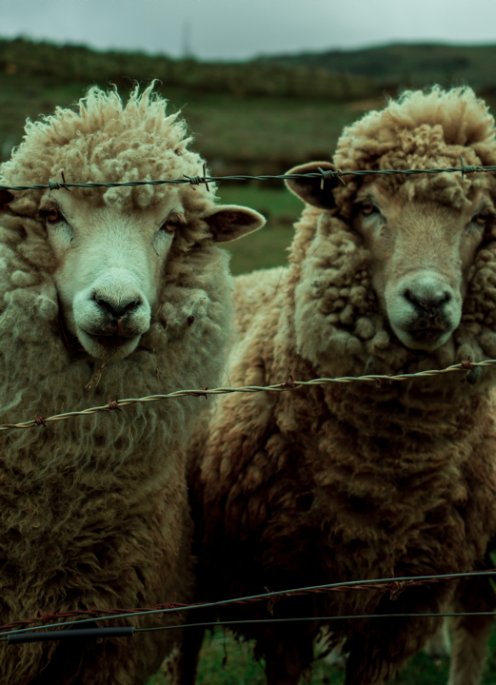
Ezekiel 34:2-6
Woe to you shepherds of Israel who only take care of yourselves! Should not shepherds take care of the flock?...
You have not strengthened the weak or healed the sick or bound up the injured. You have not brought back the strays or searched for the lost. You have ruled them harshly and brutally.
So, they were scattered because there was no shepherd, and when they were scattered, they became food for all the wild animals.
My sheep wandered over all the mountains and on every high hill. They were scattered over the whole earth, and no one searched or looked for them.
Photo by Alejo on Unsplash

Slide 8

Unhelpful beliefs
Photo by Salman Hossain Saif on Unsplash
I am responsible for my family/church, and I must do whatever it takes, even if it hurts them, to help them be perfect.
I am the head of the family/church and I need to show that I am in charge.
It is my right to treat my family/church members/others how I want to treat them.

Slide 9

Unhelpful beliefs
Photo by Jackson Simmer on Unsplash
I am responsible and accountable for the salvation of my family members/other church members, so I need to do what I can to make them do the right things.
I have felt very out of control in my own life, because I was also abused, and now I feel safest when I am in control.
My parents brought me up this way and I’m still in the church, so I know that harsh discipline is good for people.

Slide 10
The spectrum of behaviour
(L. Oakley, 2021)
Healthy Unhelpful Unhealthy Spiritual abuse

Slide 11
The spectrum of behaviour
(L. Oakley, 2021)
Healthy – nurturing and positive – loving God and loving others
Unhelpful – thoughtless things we all say and do occasionally when we are not focused on being empathic to others.
Unhealthy – the pattern of thinking, speaking and behaving unhelpfully in spiritual contexts becomes more negative and consistent, and is not open to being challenged and modified, even though it is hurtful to others.
Spiritual Abuse - If it an unhealthy appraoch becomes a persistent pattern of coercive controlling behaviour, that reflects the definition of psychological abuse with a religious rationale, it can cross the threshold into spiritual abuse.

Slide 12
An example: Healthy Behaviour
Actions
Teaching about tithing and stewardship in a way that allows a rich understanding of biblical passages and discipleship.
Accepting that people have differing abilities to give, and some may be experiencing severe financial challenges.
Response
Affirm good practice and wise, balanced, kind and loving teaching.

Slide 13
An example: Unhelpful Behaviour
Actions
Suggesting if people managed their finances better then they could give more to the church.
Being overly defensive when speaking to someone who has a different opinion to you on tithing.
Corrective response
If this is an occasional occurrence, some gentle pastoral mentoring and reflection could be helpful. Encourage them to put themselves in the shoes of other people, especially those who are struggling financially.
If they don’t understand the problem with their response, and they are not willing to adjust their teaching and interactions, consider a stronger response to prevent their behaviour from becoming unhealthy.

Slide 14
An example: Unhealthy Behaviour
Actions
Pressuring individuals or groups into giving money to the church or church-related project.
Treating people differently based on their ability to offer financial support.
Speaking in ways that are defensive and critical with people who are unable to give what is expected and desired.
Corrective response
A stronger intervention is needed to help the individual move back down the spectrum towards healthy behaviour and prevent from progressing into spiritual abuse.
Consider supervision, re-training on safeguarding, learning how to disagree without misusing power, coaching, mentoring or counselling.

Slide 15
An example: Spiritually Abuse
Actions
Consistent, intrusive, coercive requests for financial giving, often ‘supported’ by scriptures.
Suggesting that the level of giving is the true measure of an individual’s trust in God.
Making frightening threats of spiritual consequences if giving is insufficient, hoping that they will give more to reduce their fears.
Strong corrective response
If this behaviour is regularly repeated, and causes distress, then this is spiritual abuse.
This kind of behaviour is not consistent with the spiritual values of our healthy spiritual community (loving God and loving others).
If the ‘victim’ of this behaviour is a child or vulnerable adult, then this is a serious breach of safe-guarding practice that should be reported through the correct channels, where they exist.

Slide 16
Spiritual abuse and teaching children
Healthy teaching – God’s love for you never changes, whatever you do He will always love you and forgive you, and so will I.
Unhelpful teaching – When you disobey me, it makes me and God sad.
Unhealthy teaching – When you disobey me, you are also disobeying God, and putting your salvation at risk. What if Jesus comes back today?
Spiritual abuse – If you don’t obey me, it’s my responsibility to punish you harshly, so that you will learn the importance of complete and immediate obedience.

Slide 17
Abusers may use scripture or spiritual practices:
to encourage their victim to keep on forgiving them for their abuse
to keep the relationship/marriage together, and discourage the victim from leaving
to persuade the victim to make huge sacrifices for the sake of the relationship
to excuse or minimize the abuse they are inflicting on the victim
to pressurise the victim into silence, or into acceptance of the suffering

Slide 18
Abusers may use scripture or spiritual practices:
to impose gender roles that are abusive or coercive
to assert their authority, such as by reinforcing male headship and privilege
to add weight to their commands or to punish their victims
to justify abuse, or to blame the victims for their own suffering

Slide 19

Asserting Authority
Photo by Aaron Burden on Unsplash
Asserting authority happens when scripture, spiritual practices or the norms accepted within a spiritual community are used to enforce gender roles that are abusive or coercive.
It also happens when the Bible is used to create an unequal seizing of power in the relationship.
The concept of male headship and privilege may be used to force a woman to submit to a man, obey his commands, and do everything he asks to please him.
Verses from Scripture may be misquoted and distorted to threaten and punish a victim.

Slide 20

Trapping victims in abusive relationships
Scripture may be used to pressurise a victim into a cycle of abuse followed by demands for forgiveness.
Scriptures may be misused to trap the victim in a marriage or relationship and make them feel guilty for wanting to leave.
Victims may be pressured into forgiving the abuser and sacrificing their own needs for the sake of the relationship.
The abuser may use scriptures to defend their behaviour or to minimize and normalize the abuse.
Victims may be manipulated into remaining silent about the abuse, accepting the suffering as something that they deserve, or believing that the abuse will be of spiritual benefit to them.
Photo by Nick Fewings on Unsplash

Slide 21

Isolation
Photo by Hazel Aksoy on Unsplash
Abusers may isolate their victims from their spiritual communities by preventing them from attending church meetings.
Abusers may move their family to an isolated place (“We need to flee the cities!”) where they do not have any friends or family, or even a local church.
Abusers may regularly move from one community to another so that the victim cannot get spiritual support from others.
Abusers may silence their victims, be overly vigilant of their family members at church, and punish them at home if they speak to others.

Slide 22


Using coercion in the spiritual community
Abusers may persuade church leaders or other members to pressurise a victim to be forgiving, and to stay in a relationship or marriage.
Letters, special meetings, pastoral visits, and phone calls, etc. may be used to apply coercive pressure.
Often the church leaders only hear the abuser’s side of the story, and they have a distorted picture of the reality of the abusive relationship.
Photo by Markus Spiske on Unsplash

Slide 23

Victim blaming
In some contexts, abusers may use Scripture, spiritual practices and cultural norms to blame their victim and justify the abuse because the victim is “female”, “sinful”, “the ‘weaker vessel”, “estranged from God”, “not created in God’s image”, “created to serve man and be submissive”, “unclean”, etc.
Photo by Louis Galvez on Unsplash

Slide 24

Restricting access to health care
Photo by Anthony Tran on Unsplash
Abusers may use Scripture, and/or the writings of Ellen G. White, to force victims to avoid interaction with medical professionals.
They may prevent victims, and their children, from receiving medical care and attention, check ups, and medication.
They may tell their victims to pray more, have more faith, fast more and even force them to eat inadequate diets. A victim’s desire to access health care may be seen as “unspiritual” and a “lack of faith”.
They may prevent their victims from accessing family planning services, and using methods of contraception, by calling this a “sin”.

Slide 25

The devastating effects of spiritual abuse
Spiritual abuse distorts and shatters people’s picture of God.
It can hurt and discourage people so much that they give up on God.
It can break people’s faith in God and their trust in their spiritual community.
Photo by Marianna Smiley on Unsplash

Slide 26




How can we be part of the healing?
Photo by Suhyeon Choi on Unsplash
If we are not part of the healing, we may be part of the hurting.

Slide 27

Abuse versus love…
Photo by Aaron Burden on Unsplash
“Any form of abuse, then, is unacceptable behavior which directly defies God’s calling for Christ-followers to relate to each other in love. The person who abuses is sinning, the victim who wants to leave, is not in sin. While not everyone has the ability to leave an abusive partner, it is not wrong to attempt to do so if possible, the Bible encourages victims to seek safety (Proverbs 22:3 and 27:12; 1 Samuel 20; Luke 4:28-29; Acts 9:23-25; Matthew 18:15-17).
“God acts clearly through the life and death of Jesus to take an ultimate stance against all forms of violence, oppression, marginalization, and abuse, declaring that ‘God is love’ and God’s love will not stand passively or silently when women (and children or men) are abused (1 John 4:8).”
(Alley Kern)

Slide 28

Jesus
Photo by Leighann Blackwood on Unsplash
He will not crush the weakest reed or put out a flickering candle. He will bring justice to all who have been wronged. Isaiah 42:3
Psalm 103 and Psalm 23
Tender, kind, uplifting, protective
Woman caught in adultery
Woman at the well
Jesus and the children

Slide 29
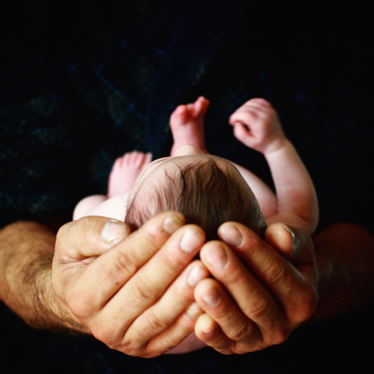
Psalm 103
The Lord is compassionate and gracious,
slow to anger, abounding in love.
⁹ He will not always accuse,
nor will he harbour his anger forever;
¹⁰ he does not treat us as our sins deserve
or repay us according to our iniquities.
¹¹ For as high as the heavens are above the earth,
so great is his love for those who fear him;
¹² as far as the east is from the west,
so far has he removed our transgressions from us.
¹³ As a father has compassion on his children,
so the Lord has compassion on those who fear him;
¹⁴ for he knows how we are formed,
he remembers that we are dust.
Photo by Jill Sauve on Unsplash

Slide 30

The perfume story
Photo by Lindsey Savage on Unsplash
There is a potential for spiritual abuse at the dinner table of Simon…
Simon - if only Jesus knew what kind of woman she is…he would not allow this.
Judas - This extravagant outpouring of perfume is a waste of good money. It could have been sold and helped the poor.
Jesus – leave her alone - you both have distorted thinking that you are using to hurt Mary. This is a beautiful gift of love to me. She is so precious that I want the story of her generous gift to be told forever.
Jesus is protective of Mary: he intervenes in the situation, he gently confronts the faulty thinking, and he lifts Mary up as a beautiful example of loving kindness forever.

Slide 31

Does their behaviour exhibit the fruit of the Spirit, and nurture the fruit of the Spirit in others?
Photo by Neha Deshmukh on Unsplash
The acts of the flesh are obvious: sexual immorality, impurity and debauchery; idolatry and witchcraft; hatred, discord, jealousy, fits of rage, selfish ambition, dissensions, factions and envy; drunkenness, orgies, and the like…
But the fruit of the Spirit is love, joy, peace, patience, kindness, goodness, faithfulness, gentleness and self-control. Against such things there is no law.
…Since we live by the Spirit, let us keep in step with the Spirit. Let us not become conceited, provoking and envying each other.
Galatians 5:19-26

Slide 32

Healthy approach
Photo by Priscilla Du Preez on Unsplash
He has shown you, O mortal, what is good and what does the Lord require of you? To act justly and to love mercy and to walk humbly with your God.
Micah 6:8

Slide 33

Empowerment
Photo by Tim Marshall on Unsplash
Empowerment is encouraging individuals, within spiritual contexts, to develop autonomy.
Healthy spiritual contexts encourage people to develop as individuals who can think for themselves, are able to express disagreement or concern, and who keep themselves and others safe.

Slide 34

Empowerment
Photo generated by PowerPoint
Survivors may need to seek out churches and church leaders who have an understanding of domestic abuse.
We need leaders and members who know how to address abuse appropriately when it is happening within their congregation and the families of the members.

Slide 35

Perfect love takes away fear
Photo generated by PowerPoint
There is no fear in love. But perfect love drives out fear, because fear has to do with punishment.
We love because he first loved us.
1 John 4:18-19.

Slide 36

Gifts not burdens…
Photo by Towfiqu Barbhuiya on Unsplash
Do not let any unwholesome talk come out of your mouths, but only what is helpful for building others up according to their needs, that it may benefit those who listen. Eph 4:29 NIV
Say only what helps – each word a gift. Message

Slide 37

Reflect
Does what I do and say push people away from God and cause them to fear me and God?
Does what I do and say bring people closer to God and help them to experience His love and mine?
Photo by Yeshi Kangrang on Unsplash

Slide 38

And this is my prayer: that your love may abound more and more in knowledge and depth of insight, so that you may be able to discern what is best and may be pure and blameless for the day of Christ, filled with the fruit of righteousness that comes through Jesus Christ - to the glory and praise of God.
Phil 1:9-11
Photo by Helena Lopes on Unsplash

