Slide 1
RESILIENT MARRIAGES
Stronger Marriages In
Hard Times
By Pastor Cyril Sweeney

Slide 2

More than 500,000 couples get married every year.
The wedding industry is big business!!!

Slide 3


Why do people want to get married?
Escape
Children
Loneliness
To be cared for
Pregnancy
6. Sex
7. Money
8. Pressure
9. Status
10. To please relatives or …….friends

Slide 4
Primary motives for two people to marry:
TO GLORIFY GOD
1 Cor 10:31 “Therefore, whether you eat or drink, or whatever you do, do all to the glory of God.”
Isa 43:7 “Everyone who is called by My name, Whom I have created for My glory; I have formed him, yes, I have made him.”
John 8:29 “And He who sent Me is with Me. The Father has not left Me alone, for I always do those things that please Him.”
Notes:
learn the skills
Healthy couples that recognize they can't solve problems together make it a point to read books, attend workshops, counseling or other methods to learn the skills.
They set speaking rules and actively practice good communication every day and create weekly time together to deal with difficult issues.

Slide 5
TO SHARE THE EXPERIENCE OF MUTUAL LOVE 1 Cor 13: 4 – 8 ⁴ Love suffers long and is kind; love does not envy; love does not parade itself, is not puffed up; ⁵ does not behave rudely, does not seek its own, is not provoked, thinks no evil; ⁶ does not rejoice in iniquity, but rejoices in the truth; ⁷ bears all things, believes all things, hopes all things, endures all things. ⁸ Love never fails. But whether there are prophecies, they will fail; whether there are tongues, they will cease; whether there is knowledge, it will vanish away.
Primary motives for two people to marry:
Notes:
learn the skills
Healthy couples that recognize they can't solve problems together make it a point to read books, attend workshops, counseling or other methods to learn the skills.
They set speaking rules and actively practice good communication every day and create weekly time together to deal with difficult issues.

Slide 6
TO SHARE THE EXPERIENCE OF MUTUAL LOVE Eph 5: 25, 28 ²⁵ Husbands, love your wives, just as Christ also loved the church and gave Himself for her, ²⁸ So husbands ought to love their own wives as their own bodies; he who loves his wife loves himself. Col 3: 19 “Husbands, love your wives and do not be bitter toward them.” Titus 2: 4 “ that they admonish the young women to love their husbands, to love their children”
Primary motives for two people to marry:
Notes:
learn the skills
Healthy couples that recognize they can't solve problems together make it a point to read books, attend workshops, counseling or other methods to learn the skills.
They set speaking rules and actively practice good communication every day and create weekly time together to deal with difficult issues.

Slide 7
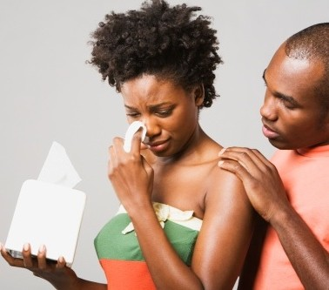
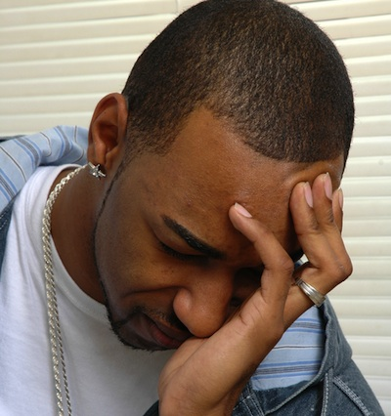
WHAT CAN KILL A MARRIAGE !!!

Slide 8
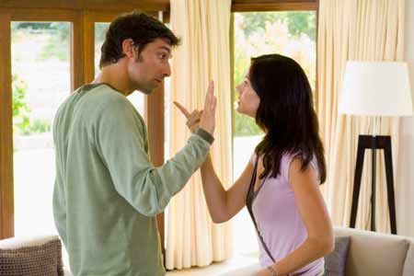
1. Communication Breakdown

Slide 9

2. Sex Difficulties
Dishonesty

Slide 10

3. Boredom

Slide 11

4. Growing apart

Slide 12

5. Money problems

Slide 13

6. Selfishness

Slide 14
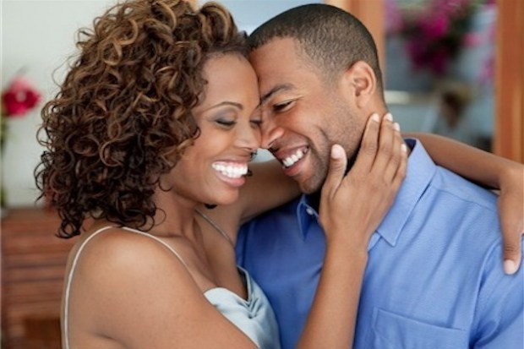

HOW TO MAKE YOUR MARRIAGE COME ALIVE!!!

Slide 15

The true principles for success and happiness in love and marriage are found in the Bible.

Slide 16
God is the best marriage counsellor.
Isa 9: 6
“For unto us a Child is born, Unto us a Son is given; And the government will be upon His shoulder. And His name will be called Wonderful, Counselor, Mighty God, Everlasting Father, Prince of Peace.”
Prov 3:6
“In all your ways acknowledge Him, And He shall direct your paths.”
James 1:5
“If any of you lacks wisdom, let him ask of God, who gives to all liberally and without reproach, and it will be given to him.”

Slide 17

Ten Keys to marital bliss:
Communication
2. Consistent worship
3. Christ in the heart …..and home
4. Commitment
5. Conflict management
6. Compassion
7. Conjugal harmony
8. Cash management
9. Caring
10. Consummate love

Slide 18
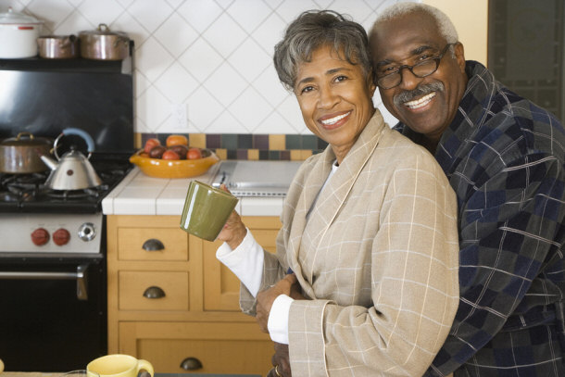
Good marriages do not happen by accident. They come by couples who are prepared to put the effort in. God wants happy marriages and happy homes.

