Slide 1
The 8 T’s of Grateful Living POWERPOINT INSTRUCTIONS (Delete this slide before presenting! ☺)
All the work is done! ☺
These slides are simply a helpful guide to get you started on the 8 T’s of Grateful Living theme. You can add, delete or edit them to suit your personal message.
REMEMBER to download the correct Sermon Script (it’s editable too), from the Grateful Living website, because it gives a suggested script for each slide.
To insert a New Slide. Select New Slide or Layout and select from the 25 x slide templates.* Then simply insert your own text and images onto the slides.
*If you would like to edit the 25 Master templates or make additional slide templates you will need to do the following: Select View > Master > Slide Master.
You can then duplicate a slide layout and make the changes you want.
When you're done, simply select Close Master View.

Slide 2
Why should we encourage Grateful Living? (Delete this slide before presenting! ☺)
Because an ‘attitude of gratitude’ is good for us, and it’s God will! (1 Thess. 5:16-18; Prov. 17:22; Eph. 5:20; 2 Cor. 4:15)
This series of Grateful Living messages falls under the category of what we often call ‘stewardship’—managing the things that God gives us—but for many listeners these messages will open up a whole new way of living abundantly (John 10:10).
You see, it’s simple, yet profound. God is love, and because he loves he gives (see John 3:16). God calls us to be faithful stewards of His love by loving Him and giving His love to others. We do this by sharing all that we have and are.
The very heart and foundation of stewardship isn’t money, it’s love.
At it’s very essence, Faithful Stewardship = Loving God and people with all we have and all we are. We are to love God and people with everything, with our 8 T’s—Time, Talents Testimony, Temple, Treasure, Territory, Tribe and God’s Truth.
In the book Counsels on Stewardship by Ellen G. White, the word ‘love’ is used 36 times in just the first 18 pages! Love is the foundation of stewardship.
When we understand God’s love we live gratefully. Grateful Living is about whole-of-life giving. God gives to us so that we can give to others. “And God is able to make all grace abound to you, so that in all things at all times having all that you need you will abound in every good work.” (2 Corinthians 9:8)
The gospel calls for a whole new way of living, grateful living, and it places love at the centre. When we love like God loves, “when we love the world as He has loved it, then for us His mission is accomplished. We are fitted for heaven; for we have heaven in our hearts.” (Ellen G. White, The Desire of Ages, p. 641)
So, is this 8 Pillars of Grateful Living really a stewardship series? Yes, because grateful living leads to cheerful giving, not only more faithful tithing and generous, systematic offerings, but whole-of-life giving, and that’s what God invites us to experience.
Welcome! to a whole new level of Christ-centred abundant living.

Slide 3
Grateful Living Topic: TIME Message Overview (Delete this slide before presenting! ☺)
Key Scriptures: Psalm 90:12; Ecclesiastes 3:1; Ephesians 5:15-17
Key EGW Writings: Christ’s Object Lessons, pp. 342-346; Pastoral Ministry pp. 81-82
Goal: Encouraging and inspiring people to dedicate time every day, and even weeks and years of their life, to God and His work.
Interview Idea: Is there an inspiring person in your church or wider community who you can interview (maybe even by phone or Zoom) about glorifying God through effective time management?

Slide 4
The slides for the actual presentation start on slide #5. (Delete this slide before presenting! ☺)

Slide 6
The 2-minute video called
Grateful Living Introduction
can be inserted and/or shown here.
The video can be downloaded at https://stewardship.adventistchurch.com/grateful-living/
Or simply delete this slide if you’re not showing the video.

Slide 8
Music: Anna Beaden & Kemy Ogendi

Slide 10
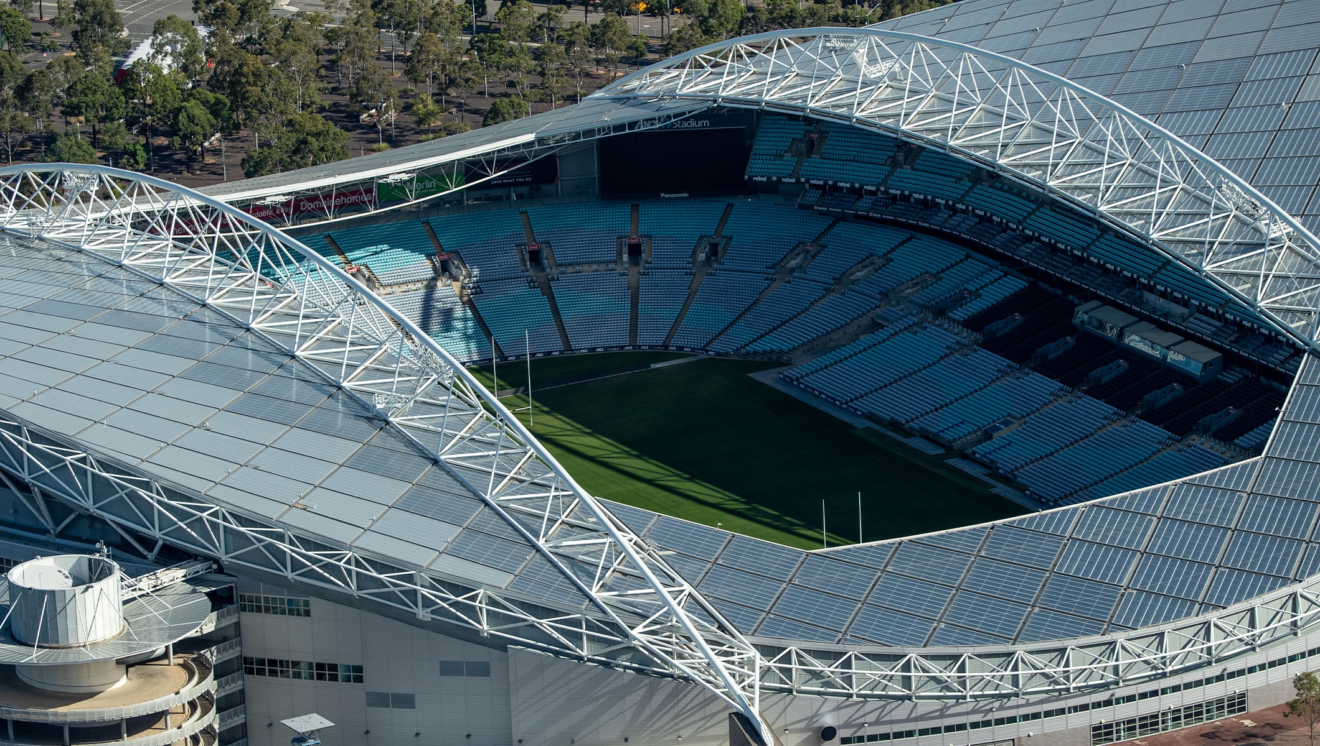

Slide 11
If the ANZ Stadium were watertight, how long would we have to get out of the stadium so that we didn’t drown?

Slide 12
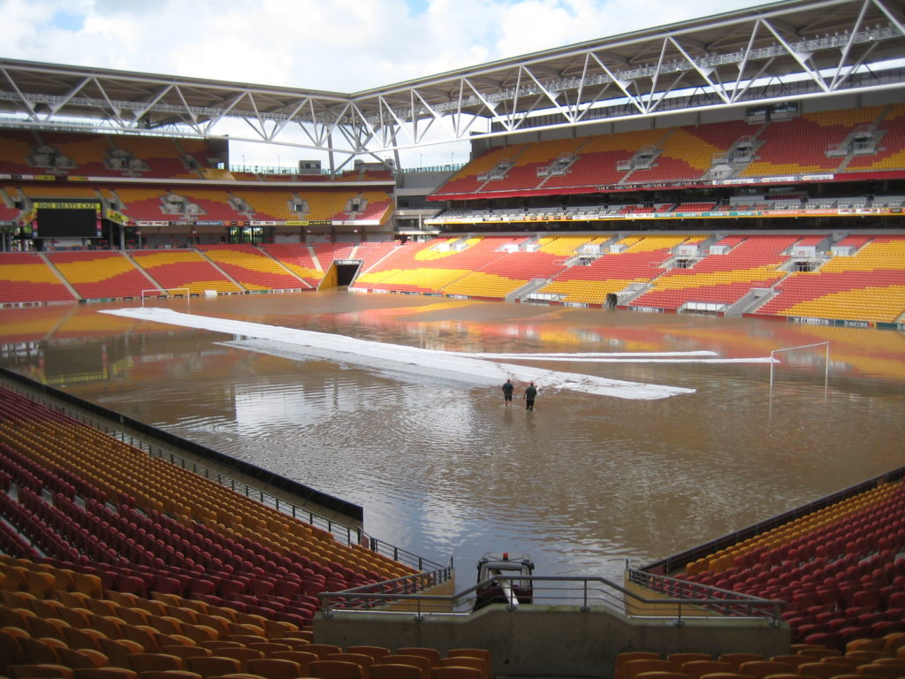
By 12:44pm - Only 1.5m of water

Slide 13
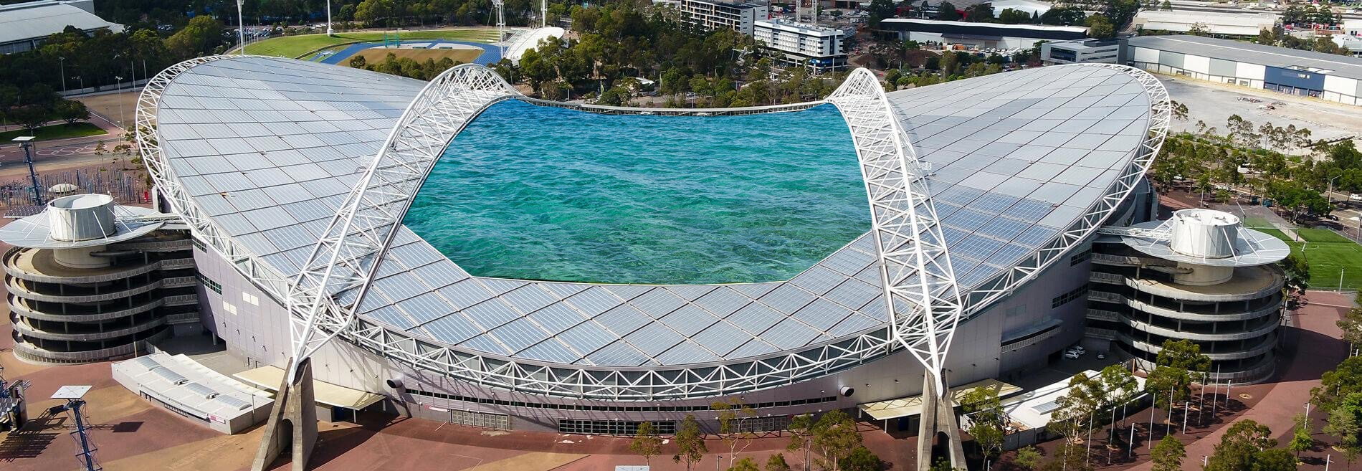
Just 5 minutes later.

Slide 14
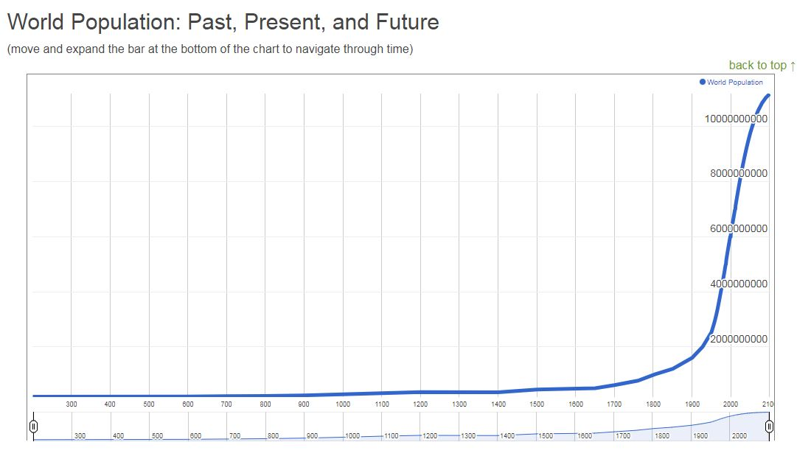

Slide 15
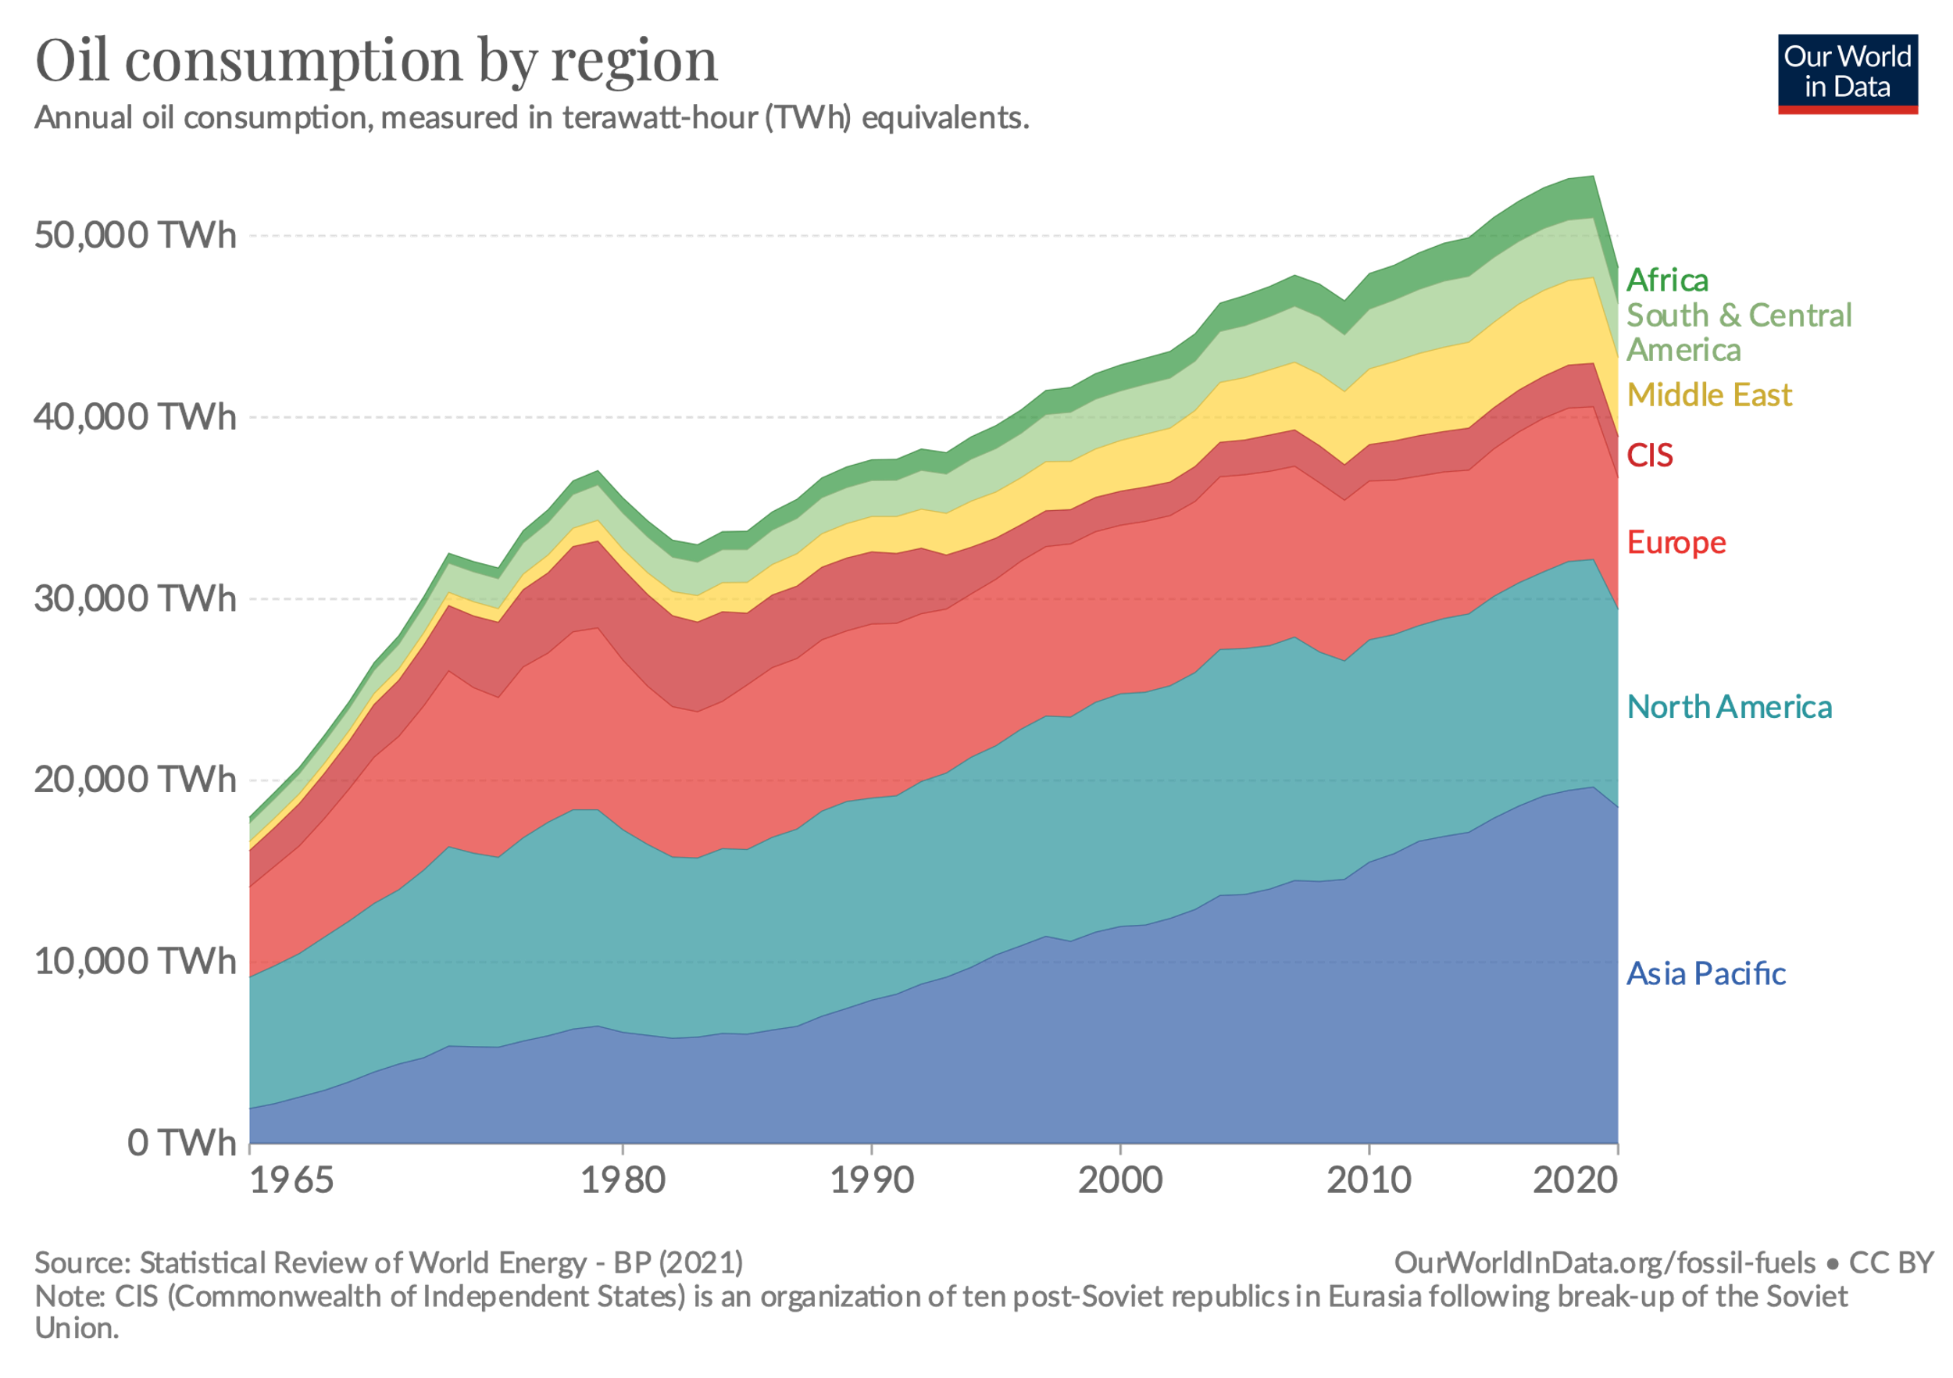
Oil usage

Slide 16
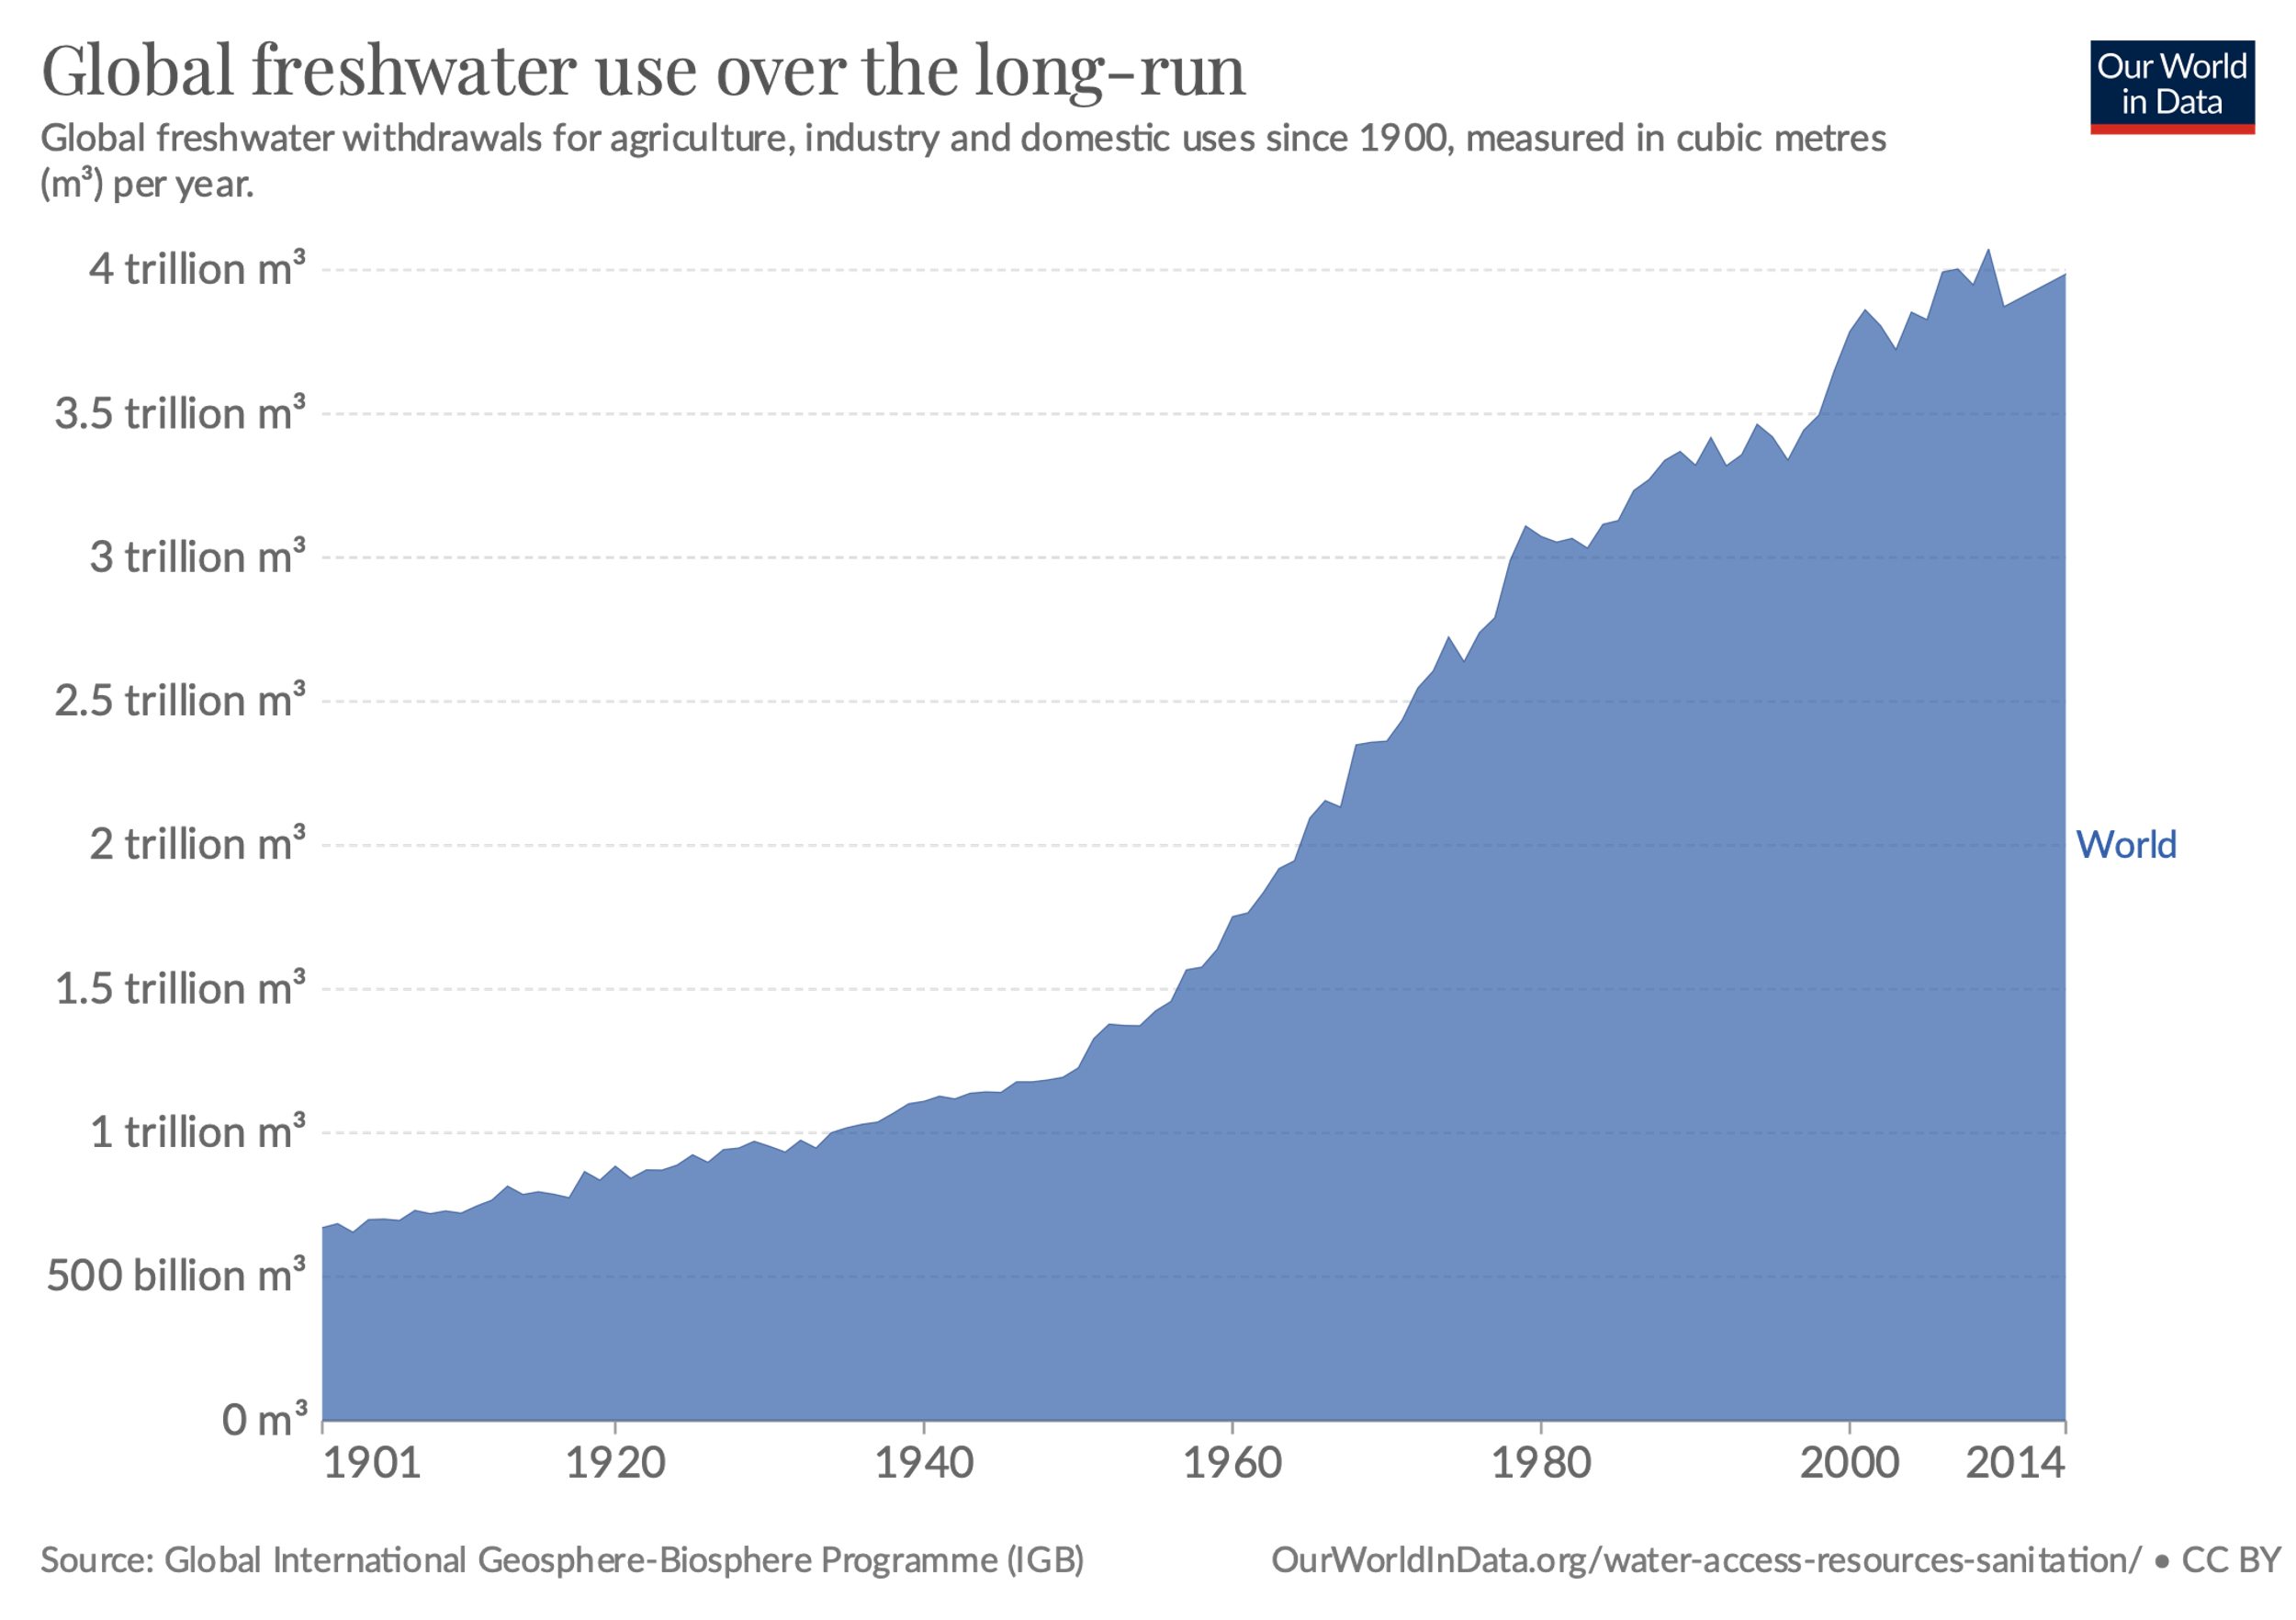
Freshwater Usage

Slide 17
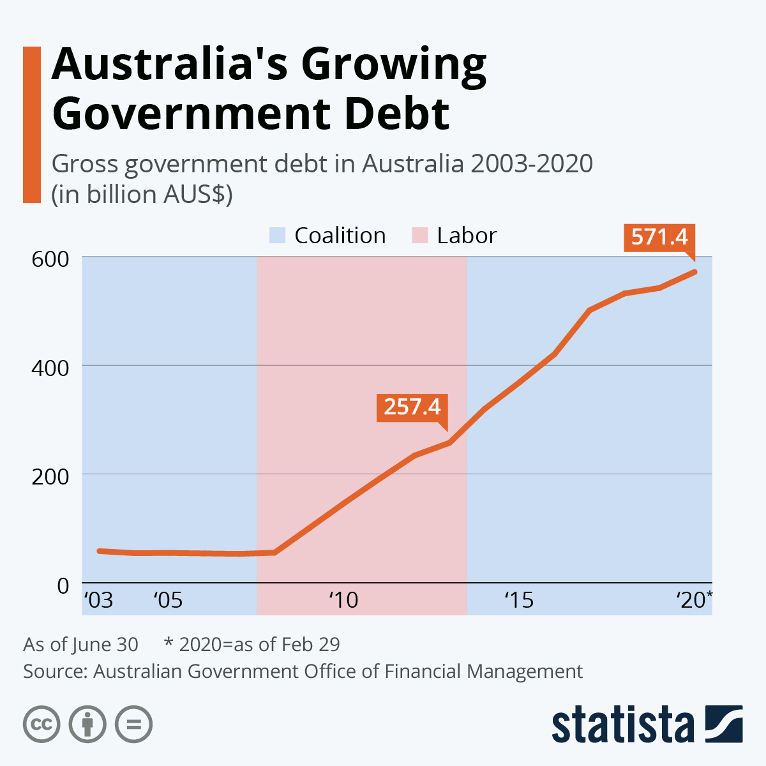
Government Debt

Slide 18
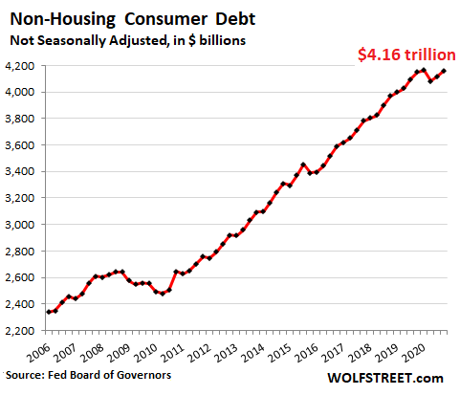
Consumer Debt

Slide 19
A 5-minute difference on an exponential curve.

Slide 20
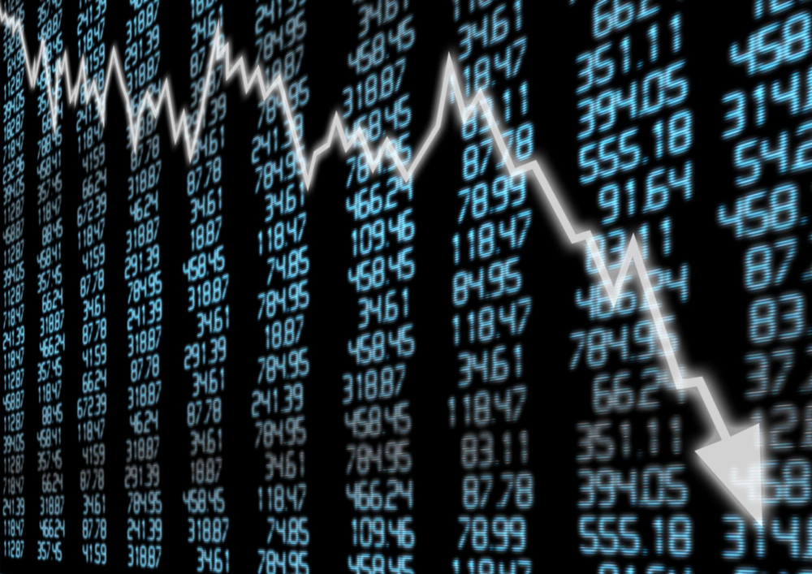


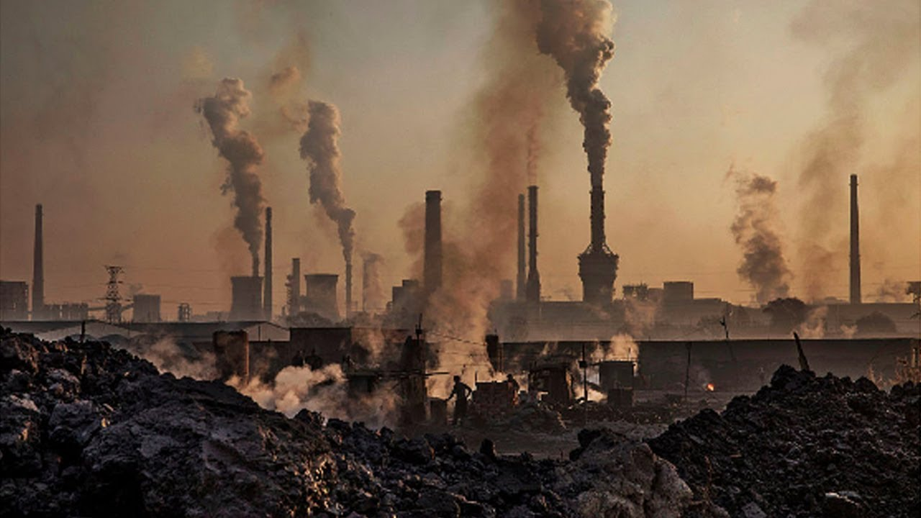

Slide 21
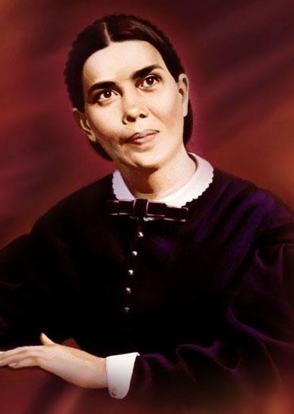
“Great changes are soon to take place in our world, and the final movements will be rapid ones.”
Ellen G. White, Testimonies v. 9, p.11

Slide 22

“Our time belongs to God. Every moment is His, and we are under the most solemn obligation to improve it to His glory. Of no talent He has given will He require a more strict account than of our time.”
Ellen G. White, Christ’s Object Lessons, 342

Slide 23
How might we best manage the TIME that God has entrusted to us?

Slide 24

God’s Blueprint
Satan’s Counterfeit
Every moment is a precious gift and I will be most blessed if I use it for His glory.
God created the world in six literal, 24-hour days and rested on the 7th.
Busyness can take us away from God.
Earth’s time will soon be finished.
Today is the day of salvation, I mustn’t delay my commitment to God.
I’ve got all the time in the world. Time is mine. I can use it how I want.
The earth evolved over millions of years, and it will just keep going.
Busyness is the best way to get ahead.
Mankind will find a way to save the planet from total destruction.
There’s no rush, make your eternal choices tomorrow.

Slide 25
[The Devil] is filled with fury, because he knows that his time is short.”
Revelation 12:12 (NIV)

Slide 26
See then that you walk circumspectly [cautiously], not as fools but as wise, redeeming the time, because the days are evil. Therefore do not be unwise, but understand what the will of the Lord is.
Ephesians 5:15-17 (NKJV)
Those who are wise will shine like the brightness of the heavens, and those who lead many to righteousness, like the stars for ever and ever.
Daniel 12:3 (NIV)

Slide 27

“We are admonished to redeem time. But time squandered can never be recovered. We cannot call back even one moment. The only way in which we can redeem our time is by making the most of that which remains, by being co-workers with God in His great plan of redemption.”
Ellen G. White, Christ’s Object Lessons, 350

Slide 28
Tip #1
Find out what role can you play in God’s mission

Slide 29
“And God has appointed these in the church: first apostles, second prophets, third teachers, then miracles, then gifts of healings, helps, administrations, varieties of tongues.”
1 Corinthians 12:26
Other passages include: creative communications, generous giving, leadership, evangelism, pastoral ministry.

Slide 30
Tip #2
Learn how to ‘number’ your Days
(Psalms 90:12)

Slide 31
Schedule your priorities instead of prioritising your schedule.

Slide 32
The wise use of TIME reflects our PRIORITIES
Devotions (Ps 46:10; Deut 6:7)
Family (Prov 5:18; Heb 10:25)
Health (Rom 12:1; 1 Cor 6:19)
4. Sabbath (Ex 20:8-11)
5. Service/Mission (Mt 6:33)
6. Useful work (Eph 4:28; Col 3:23)

Slide 33
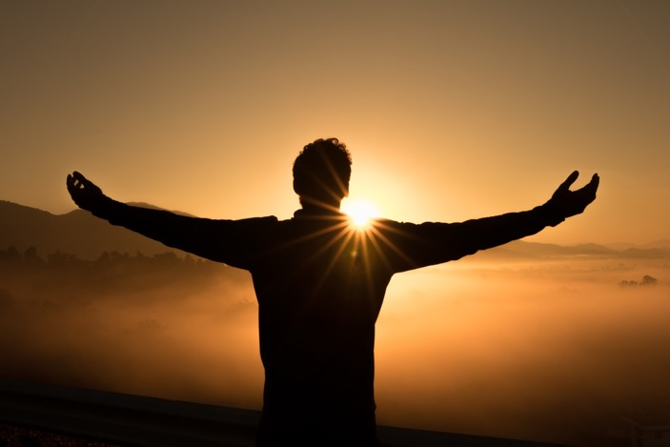
“As far as possible, it is well to consider what is to be accomplished through the day. Make a memorandum of the different duties that await your attention, and set apart a certain time for the doing of each duty … Give yourself a number of minutes to do the work, and do not stop to read papers and books that take your eye, but say to yourself, “No, I have just so many minutes in which to do my work, and I must accomplish my task in the given time.”
Ellen G. White, Child Guidance, 124

Slide 34
“Our instances are filled with eternal consequences.”
Ellen G. White, Every Day With God, 119

Slide 35
Will what I do today
make a difference in eternity?

Slide 36
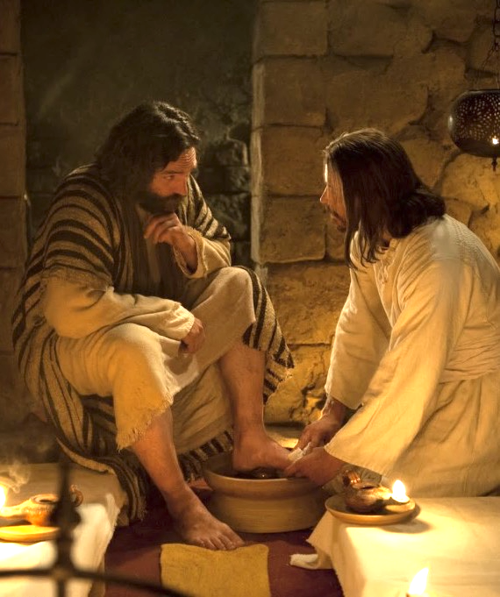
JESUS AND TIME MANAGEMENT
Jesus is our example when it comes to time management.
His time was entirely consecrated to God and to His work.
The gospels don’t portray an image of a stressed-out Jesus, but of One who is limited by time.
His time is dedicated to those who need Him.

Slide 37

God’s Time Miracle
If we set aside quality time for God every day, he will make us more efficient with the rest of our time, so that we will still accomplish the same amount or more.

Slide 38
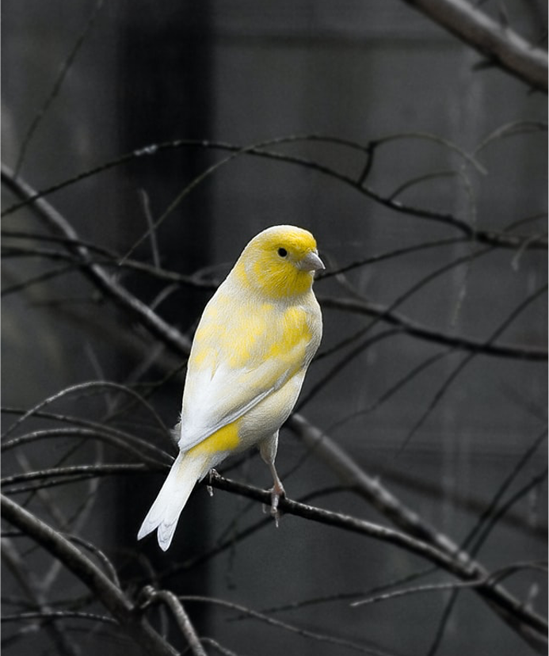
How’s your canary?
Just as the canary in the coal mine notified miners of poisonous gases, a quick look at my calendar notifies me of my life’s true focus. I can profess to be living for noble causes, but my calendar (Time) reveals what I’m actually living for.

Slide 39
DREAM SMALL
Josh Wilson
Singer/Songwriter

Slide 40
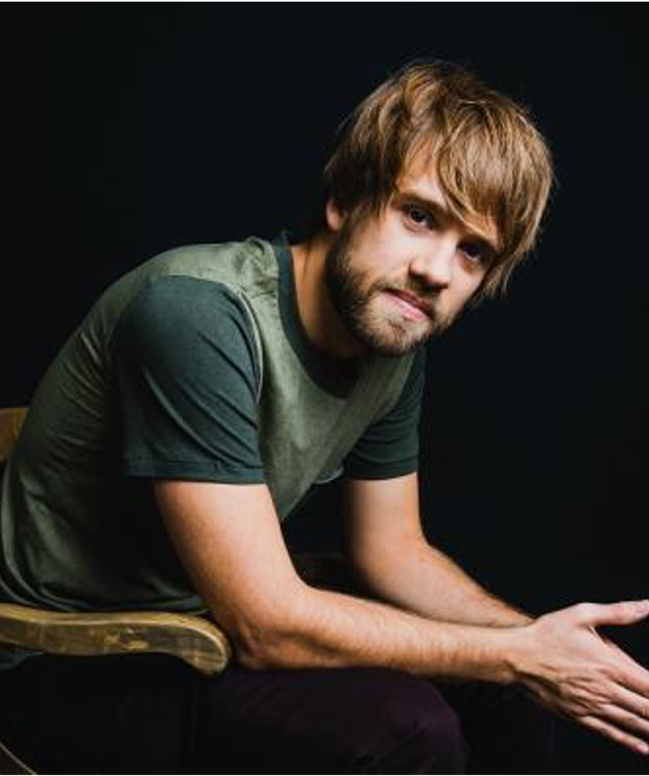
DREAM SMALL by Josh Wilson, Singer/Songwriter
It's a mother singing songs about the Lord. It's a daddy spending family time, the world says he cannot afford.
These simple moments change the world.
It's a pastor at a tiny little church. 40 years of loving on the broken and the hurt. These simple moments change the world.
Dream small.
Don't buy the lie you've got to do it all. Just let Jesus use you where you are.
One day at a time.
Live well. Loving God and others as yourself. Find little ways where only you can help. With His great love a tiny rock can make a giant fall.
So dream small.

Slide 41
DREAM SMALL by Josh Wilson, Singer/Songwriter
It's visiting the widow down the street, Or dancing on a Friday with your friend with special needs. These simple moments change the world. Of course there's nothing wrong with bigger dreams, Just don't miss the minutes on your way to bigger things. Cause these simple moments change the world. Dream small.
Don't buy the lie you've got to do it all. Just let Jesus use you where you are.
One day at a time. Live well. Loving God and others as yourself. Find little ways where only you can help. With His great love a tiny rock can make a giant fall. Dream small.

Slide 42

Q. How to be faithful with Time?
A. A faithful steward does what their Master would do if He were present.
See Counsels on Stewardship, p. 113

Slide 43


