Slide 1
The 8 T’s of Grateful Living
POWERPOINT INSTRUCTIONS
(Delete this slide before presenting! ☺)
All the work is done! ☺
These slides are simply a helpful guide to get you started on the 8 T’s of Grateful Living theme. You can add, delete or edit them to suit your personal message.
REMEMBER to download the correct Sermon Script (it’s editable too), from the Grateful Living website, because it gives a suggested script for each slide.
To insert a New Slide. Select New Slide or Layout and select from the 25 x slide templates.* Then simply insert your own text and images onto the slides.
*If you would like to edit the 25 Master templates or make additional slide templates you will need to do the following: Select View > Master > Slide Master.
You can then duplicate a slide layout and make the changes you want.
When you're done, simply select Close Master View.

Slide 2
Why should we encourage Grateful Living? (Delete this slide before presenting! ☺)
Because an ‘attitude of gratitude’ is good for us, and it’s God will! (1 Thess. 5:16-18; Prov. 17:22; Eph. 5:20; 2 Cor. 4:15)
This series of Grateful Living messages falls under the category of what we often call ‘stewardship’—managing the things that God gives us—but for many listeners these messages will open up a whole new way of living abundantly (John 10:10).
You see, it’s simple, yet profound. God is love, and because he loves he gives (see John 3:16). God calls us to be faithful stewards of His love by loving Him and giving His love to others. We do this by sharing all that we have and are.
The very heart and foundation of stewardship isn’t money, it’s love.
At it’s very essence, Faithful Stewardship = Loving God and people with all we have and all we are. We are to love God and people with everything, with our 8 T’s—Time, Talents Testimony, Temple, Treasure, Territory, Tribe and God’s Truth.
In the book Counsels on Stewardship by Ellen G. White, the word ‘love’ is used 36 times in just the first 18 pages! Love is the foundation of stewardship.
When we understand God’s love we live gratefully. Grateful Living is about whole-of-life giving. God gives to us so that we can give to others. “And God is able to make all grace abound to you, so that in all things at all times having all that you need you will abound in every good work.” (2 Corinthians 9:8)
The gospel calls for a whole new way of living, grateful living, and it places love at the centre. When we love like God loves, “when we love the world as He has loved it, then for us His mission is accomplished. We are fitted for heaven; for we have heaven in our hearts.” (Ellen G. White, The Desire of Ages, p. 641)
So, is this 8 Pillars of Grateful Living really a stewardship series? Yes, because grateful living leads to cheerful giving, not only more faithful tithing and generous, systematic offerings, but whole-of-life giving, and that’s what God invites us to experience.
Welcome! to a whole new level of Christ-centred abundant living.

Slide 3
Grateful Living Topic: TREASURE
Message Overview (Delete this slide before presenting! ☺)
Key Scriptures: Matthew 6:19-21; Malachi 3:10-12; 2 Corinthians 9:6-8
Key EGW Writings: Counsels of Stewardship (Covers the full spectrum of topics related to managing our material blessings for God’s glory.)
Extra Videos on Tithing: https://disciple.org.au/resources/god-first-tithe-video-series/
Goal: Encouraging and inspiring people to invest their God-given material blessings for God’s kingdom.
Interview Idea: Is there a person in your church or wider community who you can interview (maybe even by phone or Zoom) about investing God’s material blessings in building His kingdom?

Slide 4
The slides for the actual presentation start on slide #5.
(Delete this slide before presenting! ☺)

Slide 6
The 2-minute video called
Grateful Living Introduction
can be inserted and/or shown here.
The video can be downloaded at https://stewardship.adventistchurch.com/grateful-living/
Or simply delete this slide if you’re not showing the video.

Slide 10
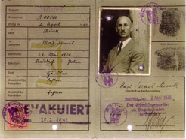
MAX ISRAEL MUNK
(1888-1972)

Slide 11
You Cannot Serve God and Money
“No one can serve two masters; for either he will hate the one and love the other, or else he will be loyal to the one and despise the other. You cannot serve God and mammon.”
Matthew 6:24 (NKJV)

Slide 12
Tithe & Offerings

Slide 13
“Thus all the tithe of the land, of the seed of the land or of the fruit of the tree, is the Lord’s; it is holy to the Lord… For every tenth part of herd or flock, whatever passes under the rod, the tenth one shall be holy to the Lord.”
Leviticus 27: 30, 32

Slide 14
“For every beast of the forest is Mine,
the cattle on a thousand hills.
“I know every bird of the mountains,
And everything that moves in the field is Mine.
“If I were hungry I would not tell you,
for the world is Mine, and all it contains.
Psalms 50:10-12

Slide 15
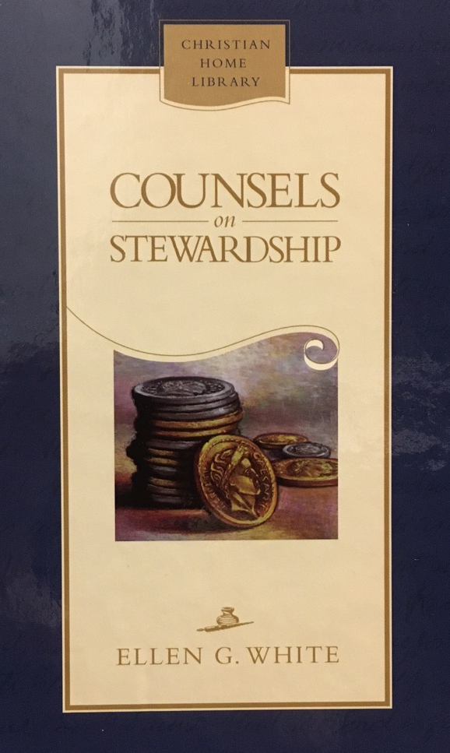
“A steward identifies himself with his master. He accepts the responsibilities of a steward, and he must act in his master's stead, doing as his master would do were he presiding. His master's interests become his. The position of a steward is one of dignity, because his master trusts him.”
Ellen G. White, Counsels on Stewardship, 113

Slide 16

God’s Blueprint
Satan’s Counterfeit
All good gifts, including my income and assets, come from God.
All that I am or can be belongs to God.
God has entrusted me to care for and grow the material gifts He has given me.
Money can very easily become an idol.
I cannot serve God and money.
When I return a faithful 10% tithe and systematic, sacrificial offerings God will bless me, guaranteed.
I work hard for every cent, so I get to choose what to do with it, not God.
My ability to earn money is to be used to increase my comfort and my lifestyle.
God’s word doesn’t give clear advice on where I should return my tithe to.
I can focus all my time and energy on making and spending money as long as I pay tithe.
A dollar is a dollar so God can’t possibly make the 90% go as far, or further, than the 100%.

Slide 17
“But this I say: He who sows sparingly will also reap sparingly, and he who sows bountifully will also reap bountifully. So let each one give as he purposes in his heart, not grudgingly or of necessity; for God loves a cheerful giver. And God is able to make all grace abound toward you, that you, always having all sufficiency in all things, may have an abundance for every good work.”
2 Corinthians 9:6-8 (NLT)

Slide 18
Where am I supposed to return my tithe to?

Slide 19
“Bring the full tithe into the storehouse,
that there may be food in my house”
Malachi 3:10 (NIV)

Slide 20
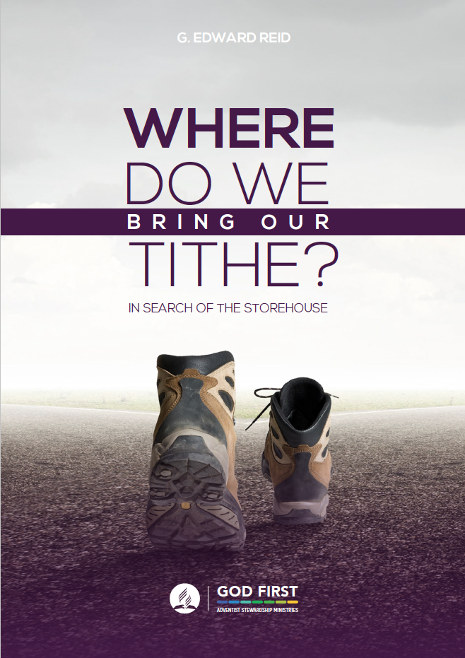
WHERE DO WE
BRING OUR TITHE?
In Search of the Storehouse
by G. Edward Reid
Download your free PDF copy at:
stewardship.adventist.org/books

Slide 21

TITHE if you love Jesus.
Anyone can HONK!

Slide 22
MY CHOICE TO RETURN TITHE & OFFERINGS
TO GOD’S STOREHOUSE SAYS:
I am GRATEFUL for everything God has done and will do for me.
I RECOGNISE that God is the owner of everything in my life.
I TRUST that God is my Provider and my Sustainer, so I will not lack anything when I trust Him with my tithe & offerings.
I TRUST in God’s Word completely, even with my money.
Money is NO LONGER an idol for me.
God’s cause is worthy of my SACRIFICE.

Slide 23
But what if I don’t trust church administrators?

Slide 24
Is the church system worthy of trust?

Slide 25
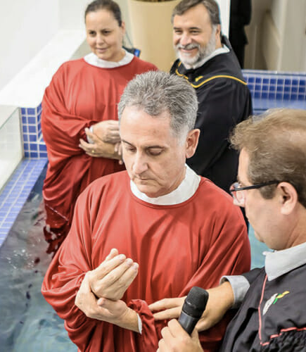
Mr. Edison da Silva – The Auditor who decided to join the church.
After contracting as an external auditor for several Adventist institutions over 15 years, he said:
“The Seventh-day Adventist Church has a sound structure, and it is an organization that carries its operations with openness and accountability.”

Slide 26
"And Jesus sat down opposite the treasury, and began observing how the people were putting money into the treasury; and many rich people were putting in large sums. A poor widow came and put in two small copper coins, which amount to a cent.
Calling His disciples to Him, He said to them, “Truly I say to you, this poor widow put in more than all the contributors to the treasury; for they all put in out of their surplus, but she, out of her poverty, put in all she owned, all she had to live on.”
Mark 12:41-44

Slide 27
Tithes and offerings are an act of worship, and our responsibility before God finishes when our ‘two mites’ drop into the bottom of the treasury box.

Slide 28
But what if I decide to not return my tithe and offerings through the Biblical channels?

Slide 29
“Will a man rob God? Yet you are robbing Me! But you say, ‘How have we robbed You?’ In tithes and offerings.
“You are cursed with a curse, for you are robbing Me, the whole nation of you!
Malachi 3:8-9

Slide 30
“Bring the all the tithes into the storehouse, so that there may be food in My house, and test Me now in this,” says the Lord of hosts, “if I will not open for you the windows of heaven and pour out for you such blessing that there will not be room enough to receive it.”
Malachi 3:10 (NKJV)

Slide 31
“You shall not put the Lord your God to the test as you tested Him at Massah.”
Deuteronomy 6:16

Slide 32
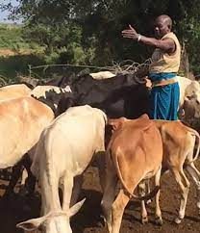
100 Cows for Tithe
The Story of Abraham

Slide 33
MAX ISRAEL MUNK
(1888-1972)

Slide 34


