Slide 1
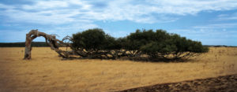
3 Best Practices For Resilient families

Slide 2
Review, repetition and Re-enforcement
Sunday
Ps John Francis
Monday
Dr Willie and Elaine Oliver
Tuesday
Ps Sweeney
Friday
Karen Holford
Thursday
Wednesday
Dr Breatrice Castratie
Ps M Campbell

Slide 3
What we will cover
What is resilience
Why families need to be resilient
3 Ways to make your family resilient
90-day resilient challenge

Slide 4

Resilience?
“The ability to withstand and rebound from disruptive life challenges.” (Walsh, 2003, p. 399)

Slide 5
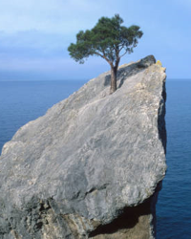
Jayne Reardon
Step 1 is the capacity to spring back instead of staying down, defeated
Step 2 requires adapting
Step 3) is thriving as a result situation.

Slide 6
“That which does not kill us makes us stronger”
Friedrich Nietzsche

Slide 7
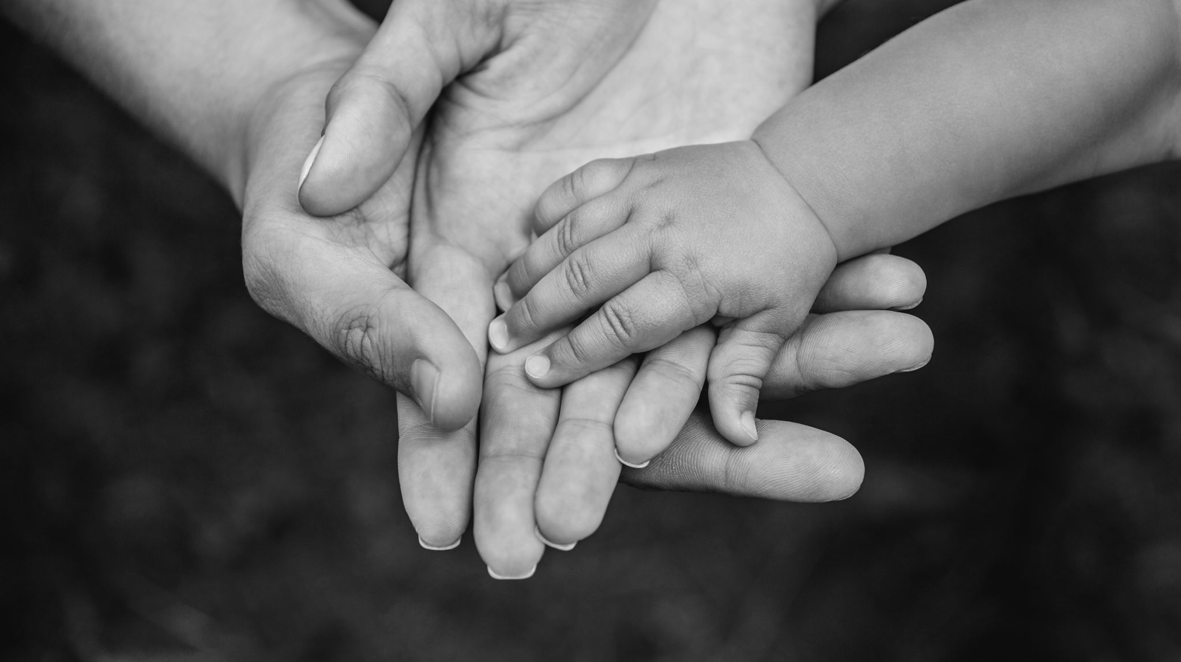
How resilient is your family? 1-10

Slide 8

What if the unthinkable happens?
Notes:
Job
Messenger of misery
John Doe
Murphy’s law

Slide 9
How to develop Resilience 3 Ws
Worship
Welcome
What to do

Slide 10
How to develop Resilience
Worship

Slide 11
For I have known him, that he commandeth his children, and his house after him (and they have kept the way of Jehovah), to do righteousness and judgment, that Jehovah may bring on Abraham that which He hath spoken concerning him.’
Gen 18:19 GNB

Slide 12
Worship – shocking stats
50 percent of first marriages end in divorce
78 percent of second marriages end in divorce
A 1997 Gallup Poll done by the National Association of Marriage Enhancement (nameonline.net) showed the divorce rate among couples who pray together regularly is 1 out of 1,152. That's way less then 1%.

Slide 13
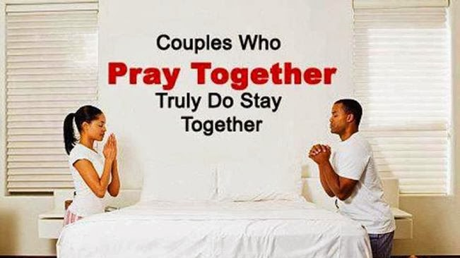
Problem: Only 11% of families pray together

Slide 14
How – AH Chp 9 EGW
In every family there should be a fixed time for morning and evening worship.
Fathers and mothers, make the hour of worship intensely interesting. The service should be short.
From time to time let the service be varied.

Slide 15
Concise
Consistent
Compellingly relevant and varied

Slide 16
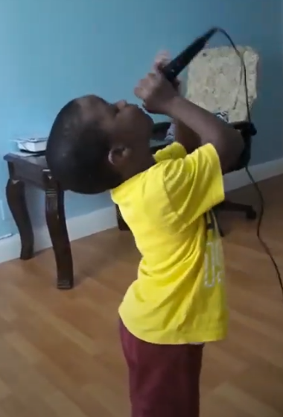
Give everyone something to do in worship

Slide 17
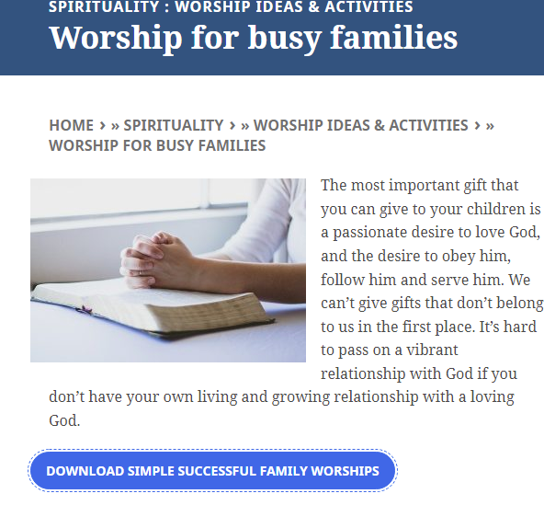
If you were actually living at the time of the story what would you taste, smell, feel and hear? How could you bring these sensory experiences into your worship time?
Karen Holdford

Slide 18
Take the time to talk to your children about your own faith and relationship with God, in ways that they can understand.
Karen Holdford

Slide 19
How to develop Resilience
Welcome resilient building experiences

Slide 20
How to get or develop resilience?
Can’t buy?
Not prescribed like moderna or phiza vaccine
Not a natural health concoction like the nature’s penicillin
Its an EXPERIENCIAL phenomenon

Slide 21
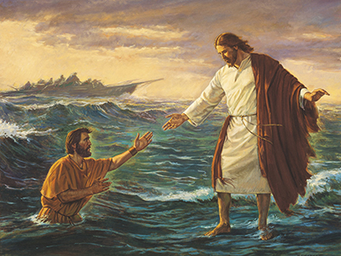
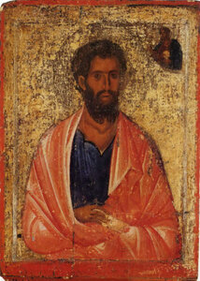
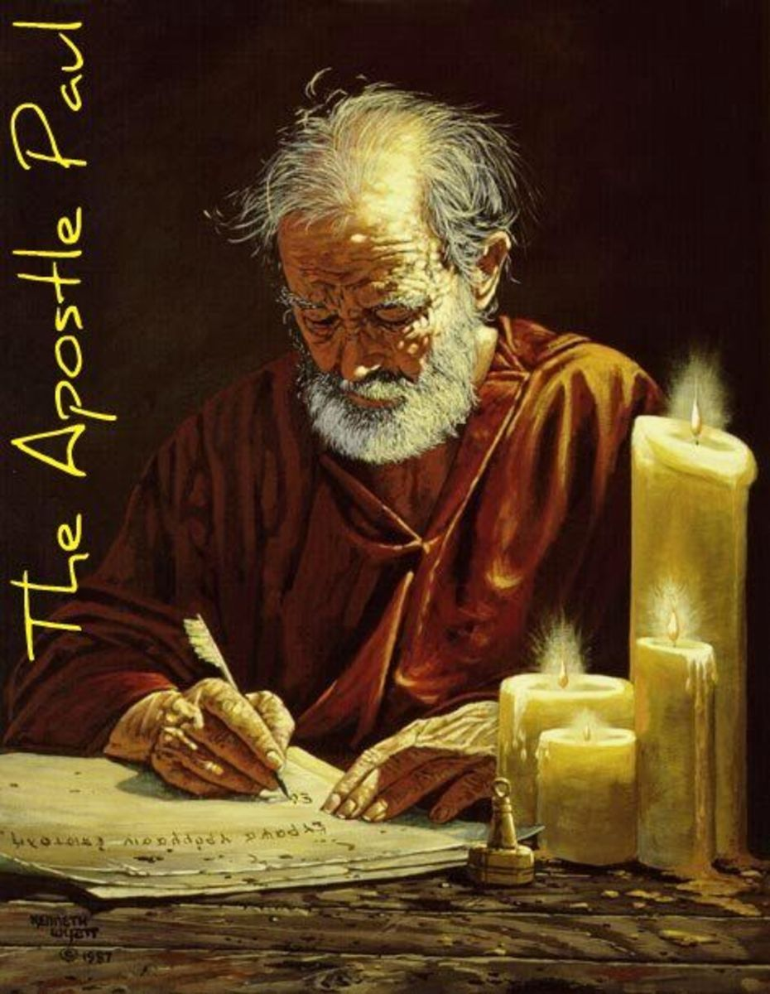
Why we should stop asking God to deliver us from troubles
Notes:
https://www.google.com/url?sa=i&url=https%3A%2F%2Forthodoxgifts.com%2Fst-james-the-brother-of-the-lord-icon%2F&psig=AOvVaw3kyEIogaA1sQC7PsU-xesO&ust=1645047493075000&source=images&cd=vfe&ved=0CAwQjhxqFwoTCIiB0tzVgvYCFQAAAAAdAAAAABAD

Slide 22
Beloved, think it not strange concerning the fiery trial which is to try you, as though some strange thing happened unto you:
But rejoice, inasmuch as ye are partakers of Christ's sufferings
1Pe 4:12,13
Notes:
https://www.google.com/url?sa=i&url=https%3A%2F%2Forthodoxgifts.com%2Fst-james-the-brother-of-the-lord-icon%2F&psig=AOvVaw3kyEIogaA1sQC7PsU-xesO&ust=1645047493075000&source=images&cd=vfe&ved=0CAwQjhxqFwoTCIiB0tzVgvYCFQAAAAAdAAAAABAD

Slide 23
Jas 1:2 My brethren, count it all joy when ye fall into divers temptations;
Notes:
https://www.google.com/url?sa=i&url=https%3A%2F%2Forthodoxgifts.com%2Fst-james-the-brother-of-the-lord-icon%2F&psig=AOvVaw3kyEIogaA1sQC7PsU-xesO&ust=1645047493075000&source=images&cd=vfe&ved=0CAwQjhxqFwoTCIiB0tzVgvYCFQAAAAAdAAAAABAD

Slide 24
And not only so, but we glory in tribulations also: knowing that tribulation worketh patience;
And patience, experience; and experience, hope:
Rom 5:3,4
Notes:
https://www.google.com/url?sa=i&url=https%3A%2F%2Forthodoxgifts.com%2Fst-james-the-brother-of-the-lord-icon%2F&psig=AOvVaw3kyEIogaA1sQC7PsU-xesO&ust=1645047493075000&source=images&cd=vfe&ved=0CAwQjhxqFwoTCIiB0tzVgvYCFQAAAAAdAAAAABAD

Slide 25
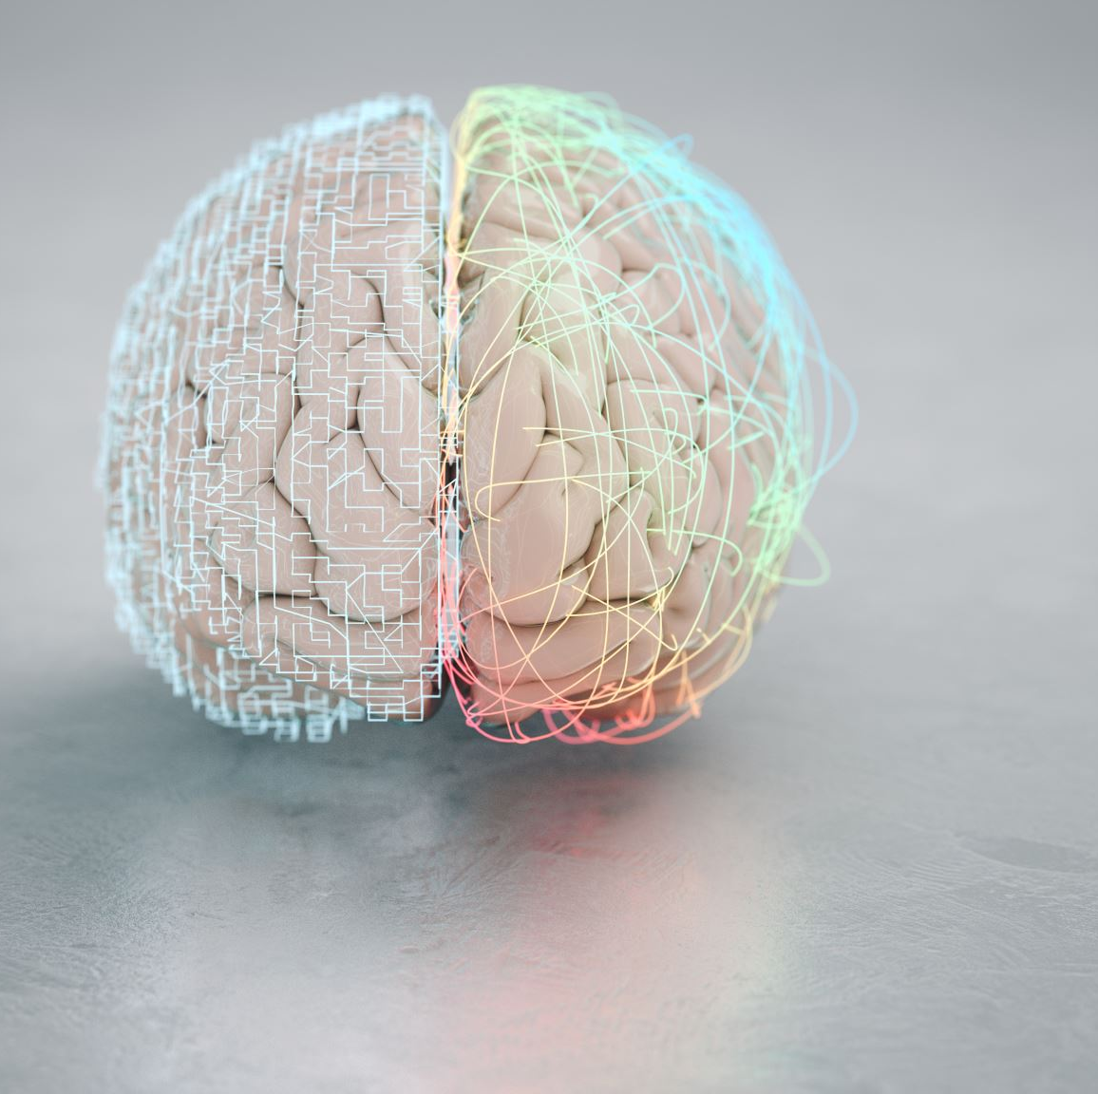
Myth and danger of the pursuit of happiness
Homeostasis of the brain

Slide 26
In all ages the Saviour's chosen have been educated and disciplined in the school of trial. They walked in narrow paths on earth; they were purified in the furnace of affliction. GC 88

Slide 27
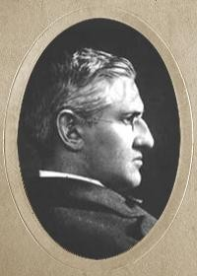
Horatio Gates Spafford
One of the greatest examples of resilience

Slide 28
How to develop Resilience
What to do

Slide 29
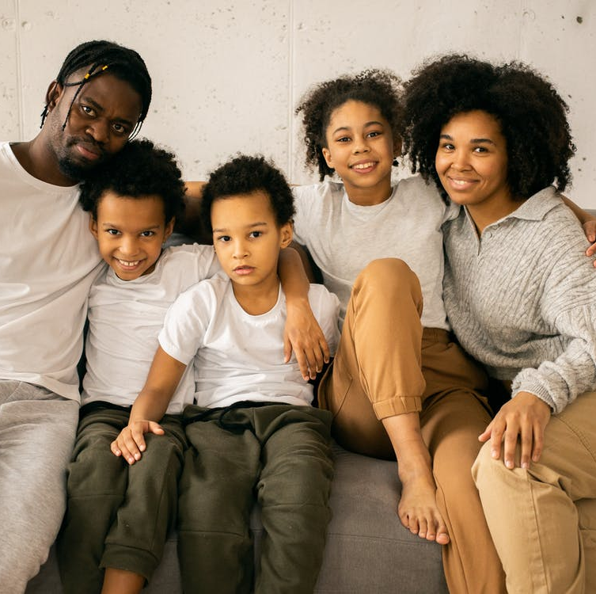
Why Families?
Notes:
Let us make for him a help meet
Be fruitful and multiply
Family is the best institution to satisfy the needs of all the members of the family

Slide 30
Abraham
¹⁹ For I have chosen him, so that he will direct his children and his household after him to keep the way of the Lord by doing what is right and just, so that the Lord will bring about for Abraham what he has promised him.” Gen 18:19

Slide 31

Best thing you can give children
Notes:
Barry black example
Learn By experience
Monkey see monkey do
Tell them of

Slide 32
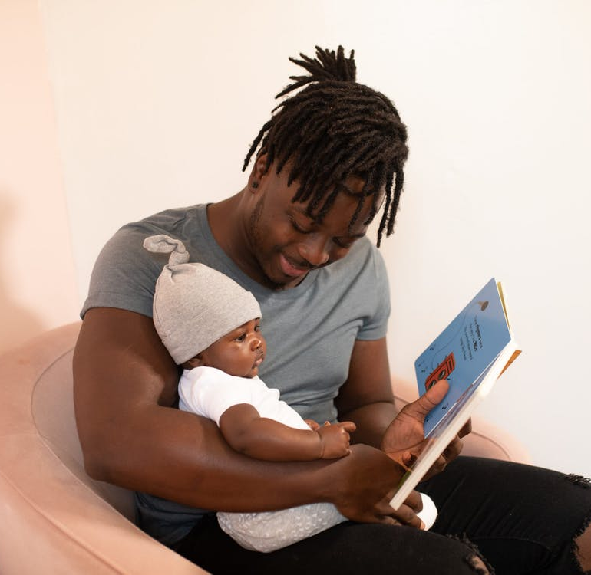
Tell children your experiences
Notes:
Story of Joseph

Slide 33
Core Needs
B
Belong
E
Enough
M
Matter
Notes:
Belong – Important part of the family – they don’t need to be in a gang or in-crowd to feel valuable – I am so gland I am part of the family of God. Behold what manner of love the father has given unto us that we might be called the children of God. Adopted children always want to find and know who the actually belong to
Enough: ____ Who works Tell of a story of Rich Holly Wood star with everything you can imagine, Awards, Houses, money cars – but din’t feel that he was enough because his father treated him like nothing – gave the dog better food then him. God come onto me… I will give you rest. Even if you were the only one in the universe he would have died for you – you don’t have to do anything, while we were yet sinners he died for us. We don’t name brand clothes, cars, education, awards we are enough.
Matter – Children and adults need to know do I really matter to you. When we feel that we matter we can face anything. For we were bought not with silver and gold but the precious blood of Jesus Christ. Children need to know that they matter. They will try all kinds of stunts to test if they really matter to you. Not because they are good, get good grades or perform good deeds they matter simply because of who they are.

Slide 34
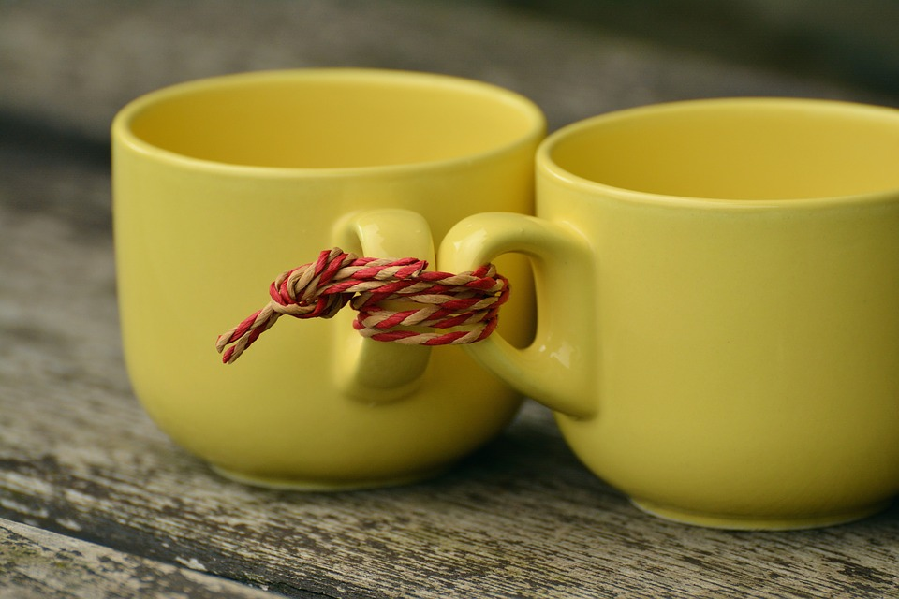
Core Needs
B
Belong
Notes:
Belong – Important part of the family – they don’t need to be in a gang or in-crowd to feel valuable – I am so gland I am part of the family of God. Behold what manner of love the father has given unto us that we might be called the children of God. Adopted children always want to find and know who the actually belong to
Enough: ____ Who works Tell of a story of Rich Holly Wood star with everything you can imagine, Awards, Houses, money cars – but din’t feel that he was enough because his father treated him like nothing – gave the dog better food then him. God come onto me… I will give you rest. Even if you were the only one in the universe he would have died for you – you don’t have to do anything, while we were yet sinners he died for us. We don’t name brand clothes, cars, education, awards we are enough.
Matter – Children and adults need to know do I really matter to you. When we feel that we matter we can face anything. For we were bought not with silver and gold but the precious blood of Jesus Christ. Children need to know that they matter. They will try all kinds of stunts to test if they really matter to you. Not because they are good, get good grades or perform good deeds they matter simply because of who they are.

Slide 35

We don’t WHO we are until we know WHOSE we are
Notes:
Our father who are in heaven
I am so glad that my father in heaven tells of his love in the book he has given

Slide 36
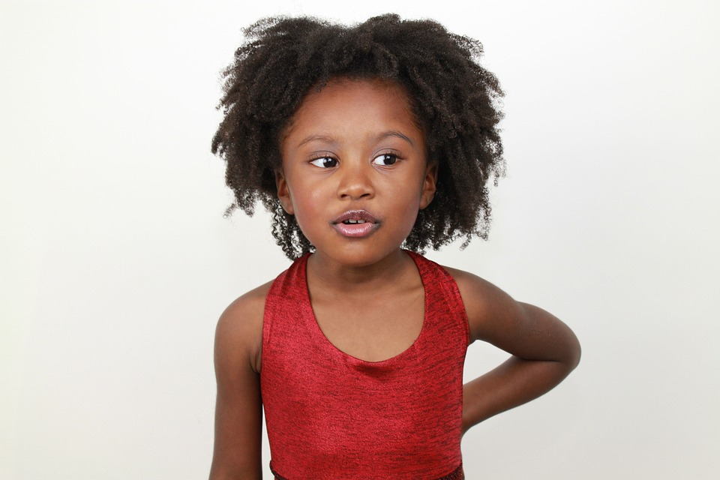
Core Needs
E
Enough
I am Enough!
Notes:
Belong – Important part of the family – they don’t need to be in a gang or in-crowd to feel valuable – I am so gland I am part of the family of God. Behold what manner of love the father has given unto us that we might be called the children of God. Adopted children always want to find and know who the actually belong to
Enough: ____ Who works Tell of a story of Rich Holly Wood star with everything you can imagine, Awards, Houses, money cars – but din’t feel that he was enough because his father treated him like nothing – gave the dog better food then him. God come onto me… I will give you rest. Even if you were the only one in the universe he would have died for you – you don’t have to do anything, while we were yet sinners he died for us. We don’t name brand clothes, cars, education, awards we are enough.
Matter – Children and adults need to know do I really matter to you. When we feel that we matter we can face anything. For we were bought not with silver and gold but the precious blood of Jesus Christ. Children need to know that they matter. They will try all kinds of stunts to test if they really matter to you. Not because they are good, get good grades or perform good deeds they matter simply because of who they are.

Slide 37

Core Needs
M
Matter
Do I Matter?
Notes:
Belong – Important part of the family – they don’t need to be in a gang or in-crowd to feel valuable – I am so gland I am part of the family of God. Behold what manner of love the father has given unto us that we might be called the children of God. Adopted children always want to find and know who the actually belong to
Enough: ____ Who works Tell of a story of Rich Holly Wood star with everything you can imagine, Awards, Houses, money cars – but din’t feel that he was enough because his father treated him like nothing – gave the dog better food then him. God come onto me… I will give you rest. Even if you were the only one in the universe he would have died for you – you don’t have to do anything, while we were yet sinners he died for us. We don’t name brand clothes, cars, education, awards we are enough.
Matter – Children and adults need to know do I really matter to you. When we feel that we matter we can face anything. For we were bought not with silver and gold but the precious blood of Jesus Christ. Children need to know that they matter. They will try all kinds of stunts to test if they really matter to you. Not because they are good, get good grades or perform good deeds they matter simply because of who they are.

Slide 38
Forasmuch as ye know that ye were not redeemed with corruptible things, as silver and gold… But with the precious blood of Christ

Slide 39
90 Day resilience challenge
Think of where you want your family to be in 90 days – image it
Decide what you need to get your family to that
Tell another family what you plan to do
Start
In 90 days update that family on your progress

