Slide 1
The 8 T’s of Grateful Living POWERPOINT INSTRUCTIONS (Delete this slide before presenting! ☺)
All the work is done! ☺
These slides are simply a helpful guide to get you started on the 8 T’s of Grateful Living theme. You can add, delete or edit them to suit your personal message.
To insert a New Slide. Select New Slide or Layout and select from the 25 x slide templates.* Then simply insert your own text and images onto the slides.
*If you would like to edit the 25 Master templates or make additional slide templates you will need to do the following: Select View > Master > Slide Master.
You can then duplicate a slide layout and make the changes you want.
When you're done, simply select Close Master View.

Slide 2
Why should we encourage Grateful Living? (Delete this slide before presenting! ☺)
Because an ‘attitude of gratitude’ is good for us, and it’s God will! (1 Thess. 5:16-18; Prov. 17:22; Eph. 5:20; 2 Cor. 4:15)
This series of Grateful Living messages falls under the category of what we often call ‘stewardship’—managing the things that God gives us—but for many listeners these messages will open up a whole new way of living abundantly (John 10:10).
You see, it’s simple, yet profound. God is love, and because he loves he gives (see John 3:16). God calls us to be faithful stewards of His love by loving Him and giving His love to others. We do this by sharing all that we have and are.
The very heart and foundation of stewardship isn’t money, it’s love.
At it’s very essence, Faithful Stewardship = Loving God and people with all we have and all we are. We are to love God and people with everything, with our 8 T’s—Time, Talents Testimony, Temple, Treasure, Territory, Tribe and God’s Truth.
In the book Counsels on Stewardship by Ellen G. White, the word ‘love’ is used 36 times in just the first 18 pages! Love is the foundation of stewardship.
When we understand God’s love we live gratefully. Grateful Living is about whole-of-life giving. God gives to us so that we can give to others. “And God is able to make all grace abound to you, so that in all things at all times having all that you need you will abound in every good work.” (2 Corinthians 9:8)
The gospel calls for a whole new way of living, grateful living, and it places love at the centre. When we love like God loves, “when we love the world as He has loved it, then for us His mission is accomplished. We are fitted for heaven; for we have heaven in our hearts.” (Ellen G. White, The Desire of Ages, p. 641)
So, is this 8 Pillars of Grateful Living really a stewardship series? Yes, because grateful living leads to cheerful giving, not only more faithful tithing and generous, systematic offerings, but whole-of-life giving, and that’s what God invites us to experience.
Welcome! to a whole new level of Christ-centred abundant living.

Slide 3
Grateful Living Topic: TALENTS Message Overview (Delete this slide before presenting! ☺)
Key Scriptures: Matthew 25:14-30 The Parable of the Talents
Key EGW Writings: Counsels of Stewardship, pp 114-126; Christ’s Object Lessons, pp. 325-365
Goal: Encouraging and inspiring people to use their God-given talents and abilities to serve Him.
Interview Idea: Is there an inspiring person in your church or wider community who you can interview (maybe even by phone or Zoom) about using their talents for God?

Slide 4
The slides for the actual presentation start on slide #5. (Delete this slide before presenting! ☺)

Slide 6
The 2-minute video called
Grateful Living Introduction
can be inserted and/or shown here.
The video can be downloaded at https://stewardship.adventistchurch.com/grateful-living/
Or simply delete this slide if you’re not showing the video.

Slide 10
The Parable of the Talents
Matthew 25:14-30

Slide 11
SDA Fundamental Belief #21
“We are God’s stewards, entrusted by Him with time and opportunities, abilities and possessions, and the blessings of the earth and its resources. We are responsible to Him for their proper use. We acknowledge God’s ownership by faithful service to Him and our fellowmen, and by returning tithes and giving offerings for the proclamation of His gospel and the support and growth of His church. Stewardship is a privilege given to us by God for nurture in love and the victory over selfishness and covetousness. The steward rejoices in the blessings that come to others as a result of his faithfulness.” (Gen. 1:26-28; 2:15; 1 Chron. 29:14; Hag. 1:3-11; Mal. 3:8-12; 1 Cor. 9:9-14; Matt. 23:23; 2 Cor. 8:1-15; Rom. 15:26,27.)
Seventh-day Adventists Believe... A Biblical Exposition of Fundamental Doctrines
(Review & Herald, 2005 ed.)

Slide 13
The Great Controversy
Talents
^
God’s Blueprint
Satan’s Counterfeit
I acknowledge that all good gifts, including talents, come from God.
All that I am or can be belongs to God.
All the applause, praise and profits that come from my talents are God’s.
God has entrusted me to care for and grow the talents He has given me.
I commit to using my God-given talents for His glory because I love Him, and He only wants what’s best for me.
God might have given you the seed of a talent but look what you’ve done with it!
All that I am or can be is a result of my focused determination and my hard work.
The applause, praise and profits that come from my talents are my reward.
I use my talents to gain respect and praise so that I can feel positive about myself.
God is happy if I use my talents all for myself as long as I give Him some credit.

Slide 14
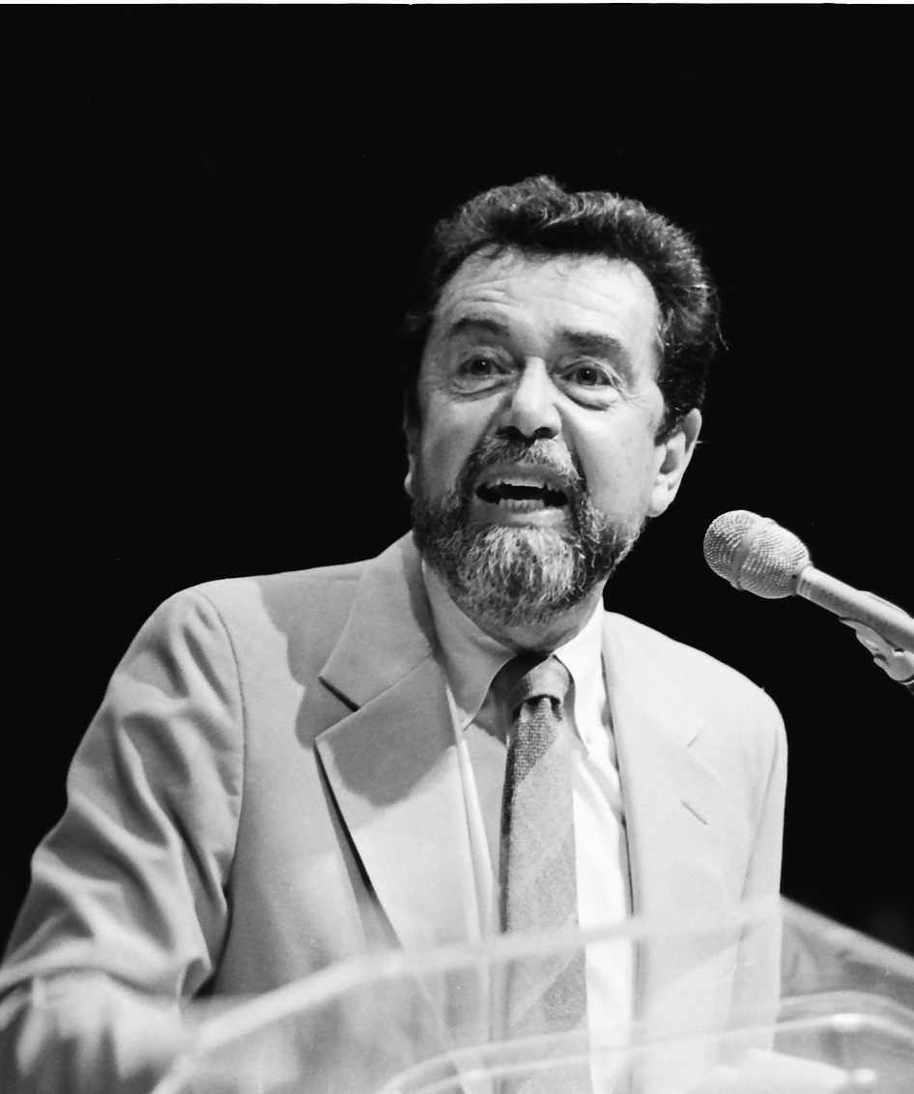
Leo Buscaglia (Author & Professor)
“Your talent is God's gift to you. What you do with it is your gift back to God.”

Slide 15
“For we are God’s handiwork, created in Christ Jesus to do good works, which God prepared in advance for us to do.”
Ephesians 2:10 (NIV)

Slide 16

“Our means, our speech, our influence—all are talents to be used in the Master’s service and to be multiplied by wise investment. We must increase our capabilities for service. It is a terrible mistake for a professed Christian to devote his time and means and energies to the service of self. We are to deny self, that we may follow Christ.”
Ellen G. White, Letters & Manuscripts, Vol. 22,
Letter 190, 1907, par. 12.

Slide 17
“Every good gift and every perfect gift is from above, and comes down from the Father of lights, ...”
James 1:17a (NKJV)

Slide 18
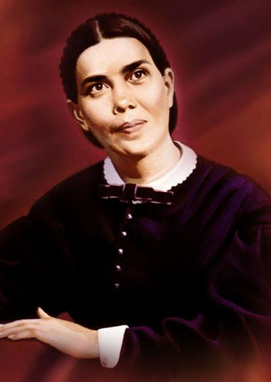
“The special gifts of the Spirit are not the only talents represented in the parable. It includes all gifts and endowments, whether original or acquired, natural or spiritual. All are to be employed in Christ's service. In becoming His disciples, we surrender ourselves to Him with all that we are and have. These gifts He returns to us purified and ennobled, to be used for His glory in blessing our fellow men.”
Ellen G. White, Christ’s Object Lessons, 328

Slide 19
“And I have filled him with the Spirit of God, in wisdom, in understanding, in knowledge, and in all manner of workmanship, to design artistic works, to work in gold, in silver, in bronze, in cutting jewels for setting, in carving wood, and to work in all manner of workmanship.”
Exodus 31:3-5 (NKJV)

Slide 20

My Trade is a Talent
“God desires that His workers in every line shall look to Him as the Giver of all they possess. … The skillful touch of the physician's hand, his power over nerve and muscle, his knowledge of the delicate organism of the body, is the wisdom of divine power, to be used in behalf of the suffering. The skill with which the carpenter uses the hammer, the strength with which the blacksmith makes the anvil ring, comes from God. He has entrusted men with talents, and He expects them to look to Him for counsel. cont …
Ellen G. White, Christ’s Object Lessons, 349

Slide 21

… Whatever we do, in whatever department of the work we are placed, He desires to control our minds that we may do perfect work. Religion and business are not two separate things; they are one. Bible religion is to be interwoven with all we do or say. Divine and human agencies are to combine in temporal as well as in spiritual achievements. They are to be united in all human pursuits, in mechanical and agricultural labours, in mercantile and scientific enterprises. There must be co-operation in everything embraced in Christian activity.”
Ellen G. White, Christ’s Object Lessons, 349

Slide 22
“Each of you should use whatever gift you have received to serve others, as faithful stewards of God’s grace in its various forms.”
1 Peter 4:10 (NIV)

Slide 23
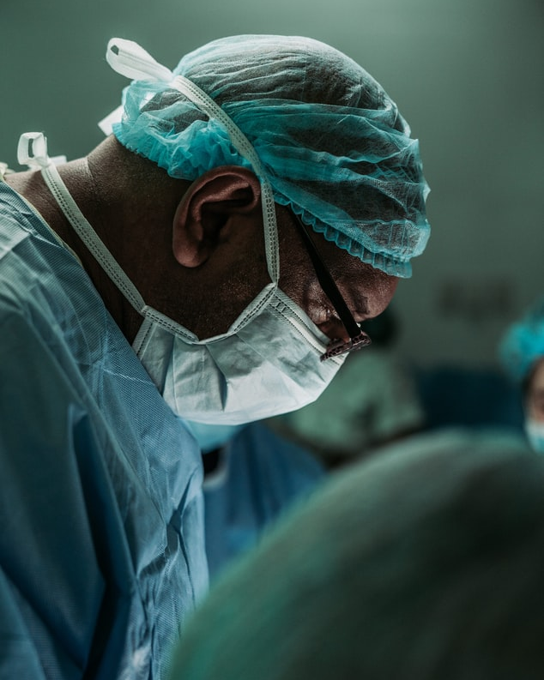
“Influence is a gift of God . . . Intellect is an entrusted talent. Sympathy and affection are talents to be sacredly guarded and improved, that we may render service to Him whose purchased possession we are. All that we are or can be belongs to God.
Education, discipline, and skill in every line should be used for Him. The capital is His, and the improvement is the usury [profit/interest] that rightfully belongs to the Master. Whether the amount entrusted is large or small, the Lord requires that His householders do their best.”
Ellen G. White, Our High Calling, 289

Slide 24

“Talents used are talents multiplied. Success is not the result of chance or of destiny; it is the outworking of:
God's own providence,
the reward of faith and discretion,
of virtue, and
persevering effort.”
Ellen G. White, Christ’s Object Lessons, p. 353

Slide 25
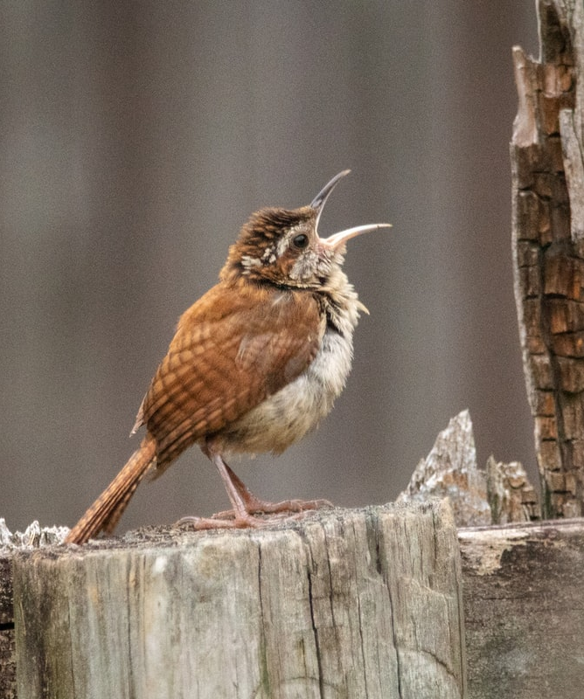
“Use what talents you possess; the woods would indeed be very silent if no birds sang there except those that sang best.”
Odd Moments, Sunshine Private Press

Slide 26
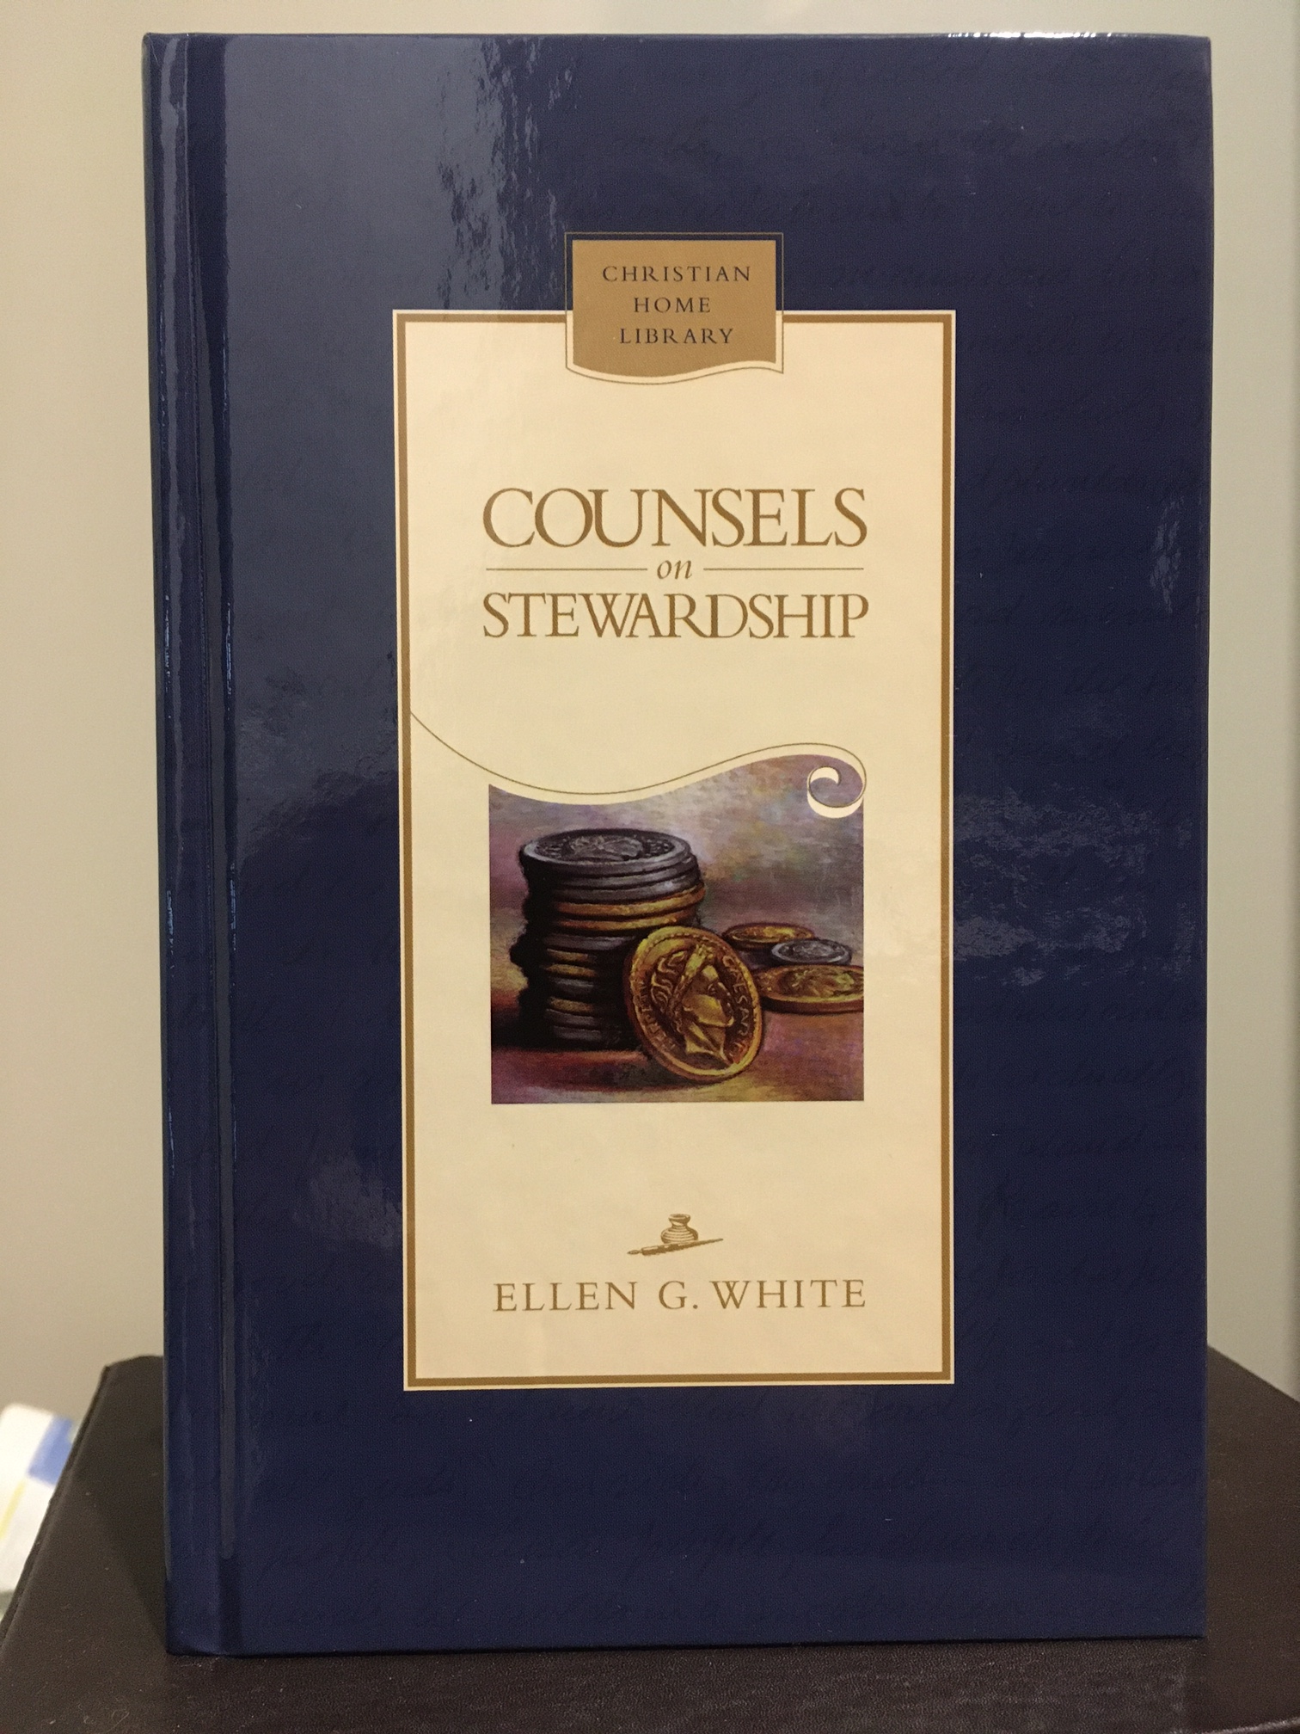

Slide 27
Illustration Story (Can be cut and pasted into presenter’s notes. Delete this slide before presenting. ☺)
Author and theology professor Haddon Robinson tells the story of a concert violinist whose brother was a bricklayer. One day, a woman began gushing to the bricklayer about how wonderful it was to be in the family of that violinist. Not wanting to insult the bricklayer, she added, “Of course, we don’t all have the same talents, and even in a family some just seem to have more talent than others.”
The bricklayer replied, “Boy, you’re telling me! That violinist brother of mine doesn’t know a thing about laying bricks. If he couldn’t make some money playing that fiddle of his, he couldn’t hire a guy with know-how like mine to build a house. If he had to build a house himself, he’d be ruined.”
Robinson’s conclusion? “If you want to build a house, you don’t want a violinist. If you’re going to lead an orchestra, you don’t want a brick-layer. No two of us are exactly alike. None of us has every gift and ability. Our responsibility is to exercise the gifts we have—not the ones we wish we had.”

Slide 28
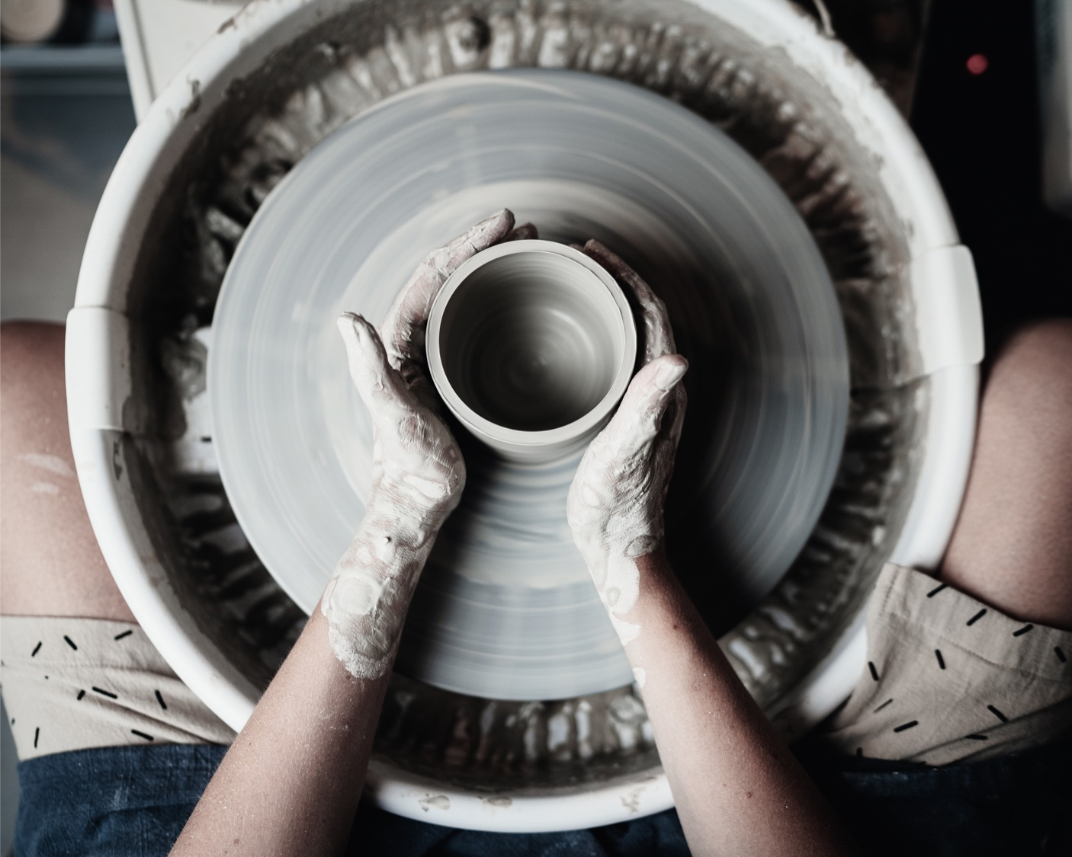
Q. How to be faithful with Talents?
A. A faithful steward does what their Master would do if He were present.
See Counsels on Stewardship, p. 113

Slide 29
Grateful living leads to cheerful giving.

