Slide 1
The 8 T’s of Grateful Living POWERPOINT INSTRUCTIONS (Delete this slide before presenting! ☺)
All the work is done! ☺
These slides are simply a helpful guide to get you started on the 8 T’s of Grateful Living theme. You can add, delete or edit them to suit your personal message.
To insert a New Slide. Select New Slide or Layout and select from the 25 x slide templates.* Then simply insert your own text and images onto the slides.
*If you would like to edit the 25 Master templates or make additional slide templates you will need to do the following: Select View > Master > Slide Master.
You can then duplicate a slide layout and make the changes you want.
When you're done, simply select Close Master View.

Slide 2
Why should we encourage Grateful Living? (Delete this slide before presenting! ☺)
Because an ‘attitude of gratitude’ is good for us, and it’s God will! (1 Thess. 5:16-18; Prov. 17:22; Eph. 5:20; 2 Cor. 4:15)
This series of Grateful Living messages falls under the category of what we often call ‘stewardship’—managing the things that God gives us—but for many listeners these messages will open up a whole new way of living abundantly (John 10:10).
You see, it’s simple, yet profound. God is love, and because he loves he gives (see John 3:16). God calls us to be faithful stewards of His love by loving Him and giving His love to others. We do this by sharing all that we have and are.
The very heart and foundation of stewardship isn’t money, it’s love.
At it’s very essence, Faithful Stewardship = Loving God and people with all we have and all we are. We are to love God and people with everything, with our 8 T’s—Time, Talents Testimony, Temple, Treasure, Territory, Tribe and God’s Truth.
In the book Counsels on Stewardship by Ellen G. White, the word ‘love’ is used 36 times in just the first 18 pages! Love is the foundation of stewardship.
When we understand God’s love we live gratefully. Grateful Living is about whole-of-life giving. God gives to us so that we can give to others. “And God is able to make all grace abound to you, so that in all things at all times having all that you need you will abound in every good work.” (2 Corinthians 9:8)
The gospel calls for a whole new way of living, grateful living, and it places love at the centre. When we love like God loves, “when we love the world as He has loved it, then for us His mission is accomplished. We are fitted for heaven; for we have heaven in our hearts.” (Ellen G. White, The Desire of Ages, p. 641)
So, is this 8 Pillars of Grateful Living really a stewardship series? Yes, because grateful living leads to cheerful giving, not only more faithful tithing and generous, systematic offerings, but whole-of-life giving, and that’s what God invites us to experience.
Welcome! to a whole new level of Christ-centred abundant living.

Slide 3
Grateful Living Topic: TRIBE Message Overview (Delete this slide before presenting! ☺)
Key Scriptures: 1 Timothy 5:8; 1 John 4:20-21; Luke 10:25-28
Key EGW Writings: The books Adventist Home & Christian Service
Goal: Caring for my immediate family, my church family and my global family.
Interview Idea: Is there an inspiring person in your church or wider community who you can interview (maybe even by phone or Zoom) about how they have cared for their ‘tribe’ in an exceptional way?

Slide 4
The slides for the actual presentation start on slide #5. (Delete this slide before presenting! ☺)

Slide 6
The 2-minute video called
Grateful Living Introduction
can be inserted and/or shown here.
The video can be downloaded at https://stewardship.adventistchurch.com/grateful-living/
Or simply delete this slide if you’re not showing the video.

Slide 10
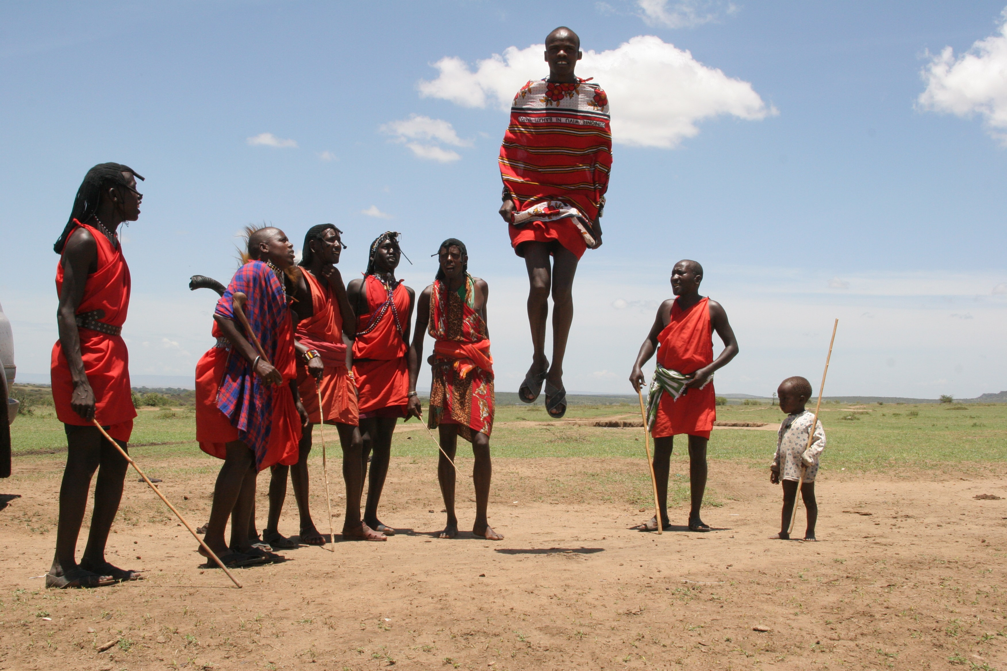
When you find people who not only tolerate your crazy ways, but celebrate them with glad cries of “Me, too!”, be sure to cherish them, because those people are your tribe!

Slide 11

My Tribe
How can I better care for my tribe—my immediate family, my church family and my global family?

Slide 12
Dick & Rick Hoyt

Slide 13
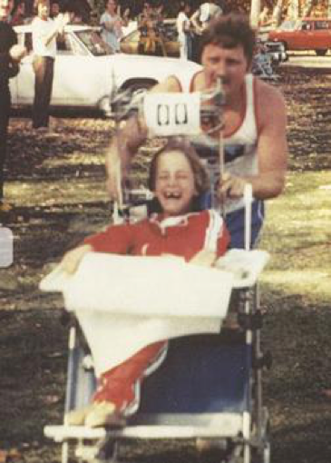
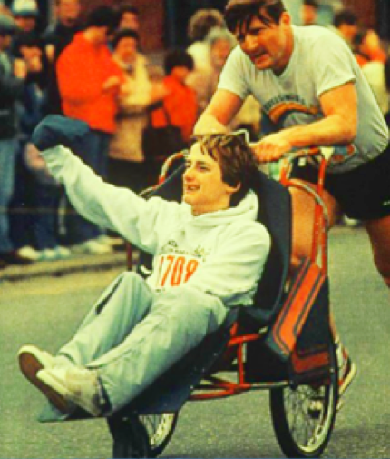
Dick & Rick Hoyt

Slide 14
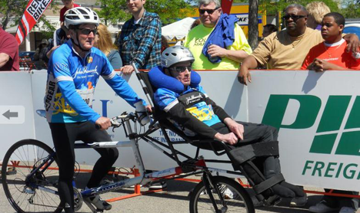
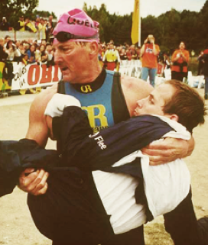
Dick & Rick Hoyt

Slide 15
Dick & Rick Hoyt
“Greater love has no one than this, than to lay down his life for his friends.”
John 15:13

Slide 16
The Great Controversy
Tribe
^
God’s Blueprint
Satan’s Counterfeit
You are your ‘brother’s keeper’.
You are responsible to provide for your family, especially in tough times.
Love and cherish your spouse just like Christ loves the church.
Do unto others as you would have them do unto you.
I am to love and care for my neighbour, even if they live in another town or country, just as I love and care for myself.
Your #1 priority is yourself.
Always let others provide for themselves, just like you have.
Focus on ensuring that your spouse cares for your needs.
It’s a dog-eats-dog world so look out for yourself at any cost to others.
It’s OK to always put my own needs in front of everyone else’s needs, especially those who don’t live near me.

Slide 17
Anyone who does not provide for their relatives, and especially for their own household, has denied the faith and is worse than an unbeliever.
1 Timothy 5:8 (NIV)

Slide 18
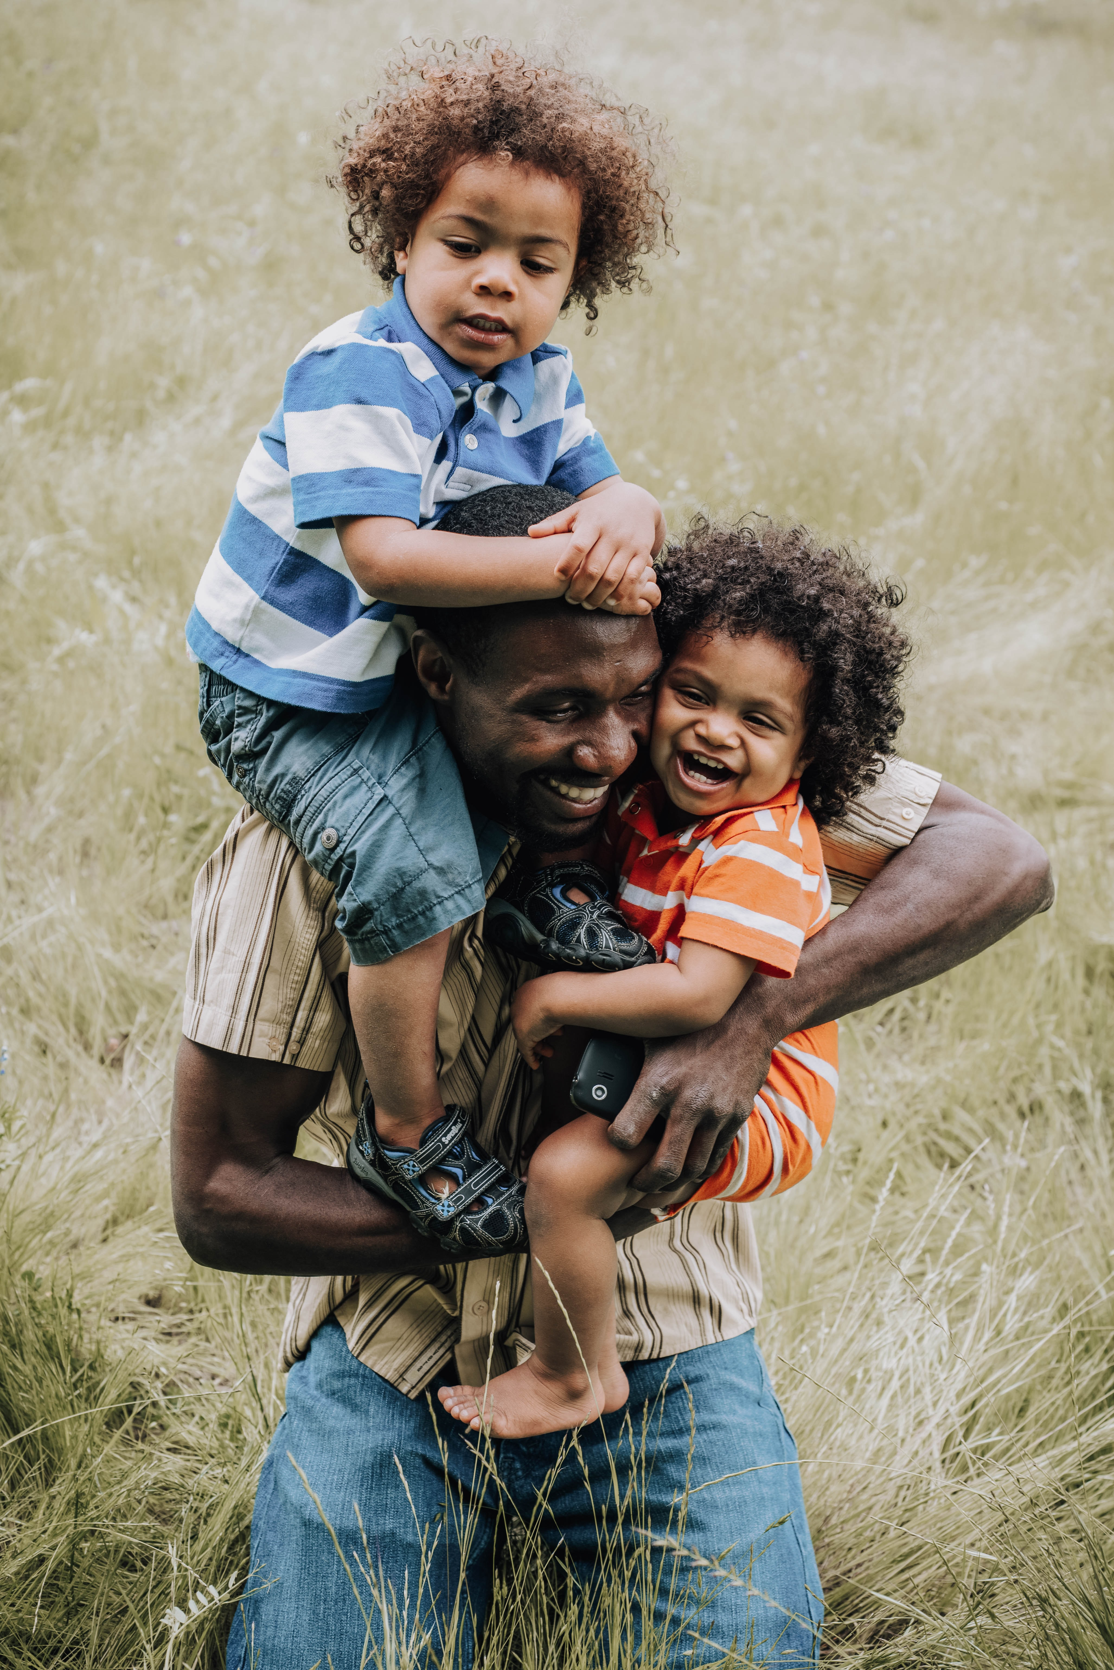
“Our work for Christ is to begin with the family, in the home. ... There is no missionary field more important than this.”
Ellen G. White, Adventist Home, 35

Slide 19

“The Lord has not called you to neglect your home ... He never works in this way; and He never will.”
Ellen G. White, Adventist Home, 246

Slide 20
So whatever you wish that others would do to you, do also to them, for this is the Law and the Prophets.
Matthew 7:12 (ESV)

Slide 21
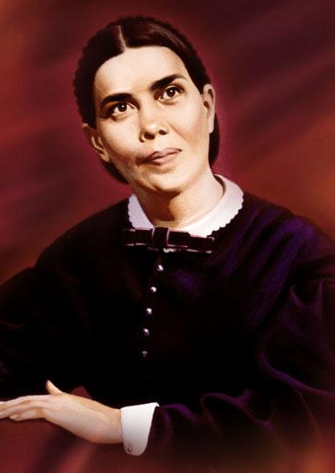
“Every uttered word exerts an influence, every action involves a train of responsibility. No one can live to himself in this world, even if he would. Each one forms a part of the great web of humanity, and through our individual threads of influence we are linked to the universe.”
Ellen G. White
Review & Herald, Feb. 16, 1897

Slide 22
If someone says, “I love God,” and hates his brother, he is a liar; for he who does not love his brother whom he has seen, how can he love God whom he has not seen? And this commandment we have from Him: that he who loves God must love his brother also.
1 John 4:20-21 (NKJV)

Slide 23

“It is not earthly rank, nor birth, nor nationality, nor religious privilege, which proves that we are members of the family of God; it is love, a love that embraces all humanity.”
Ellen G. White
Thoughts from the Mount of Blessings, 75

Slide 24
These words which I command you today shall be in your heart. You shall teach them diligently to your children, and shall talk of them when you sit in your house, when you walk by the way, when you lie down, and when you rise up.
Deuteronomy 6:6-7 (NKJV)

Slide 25
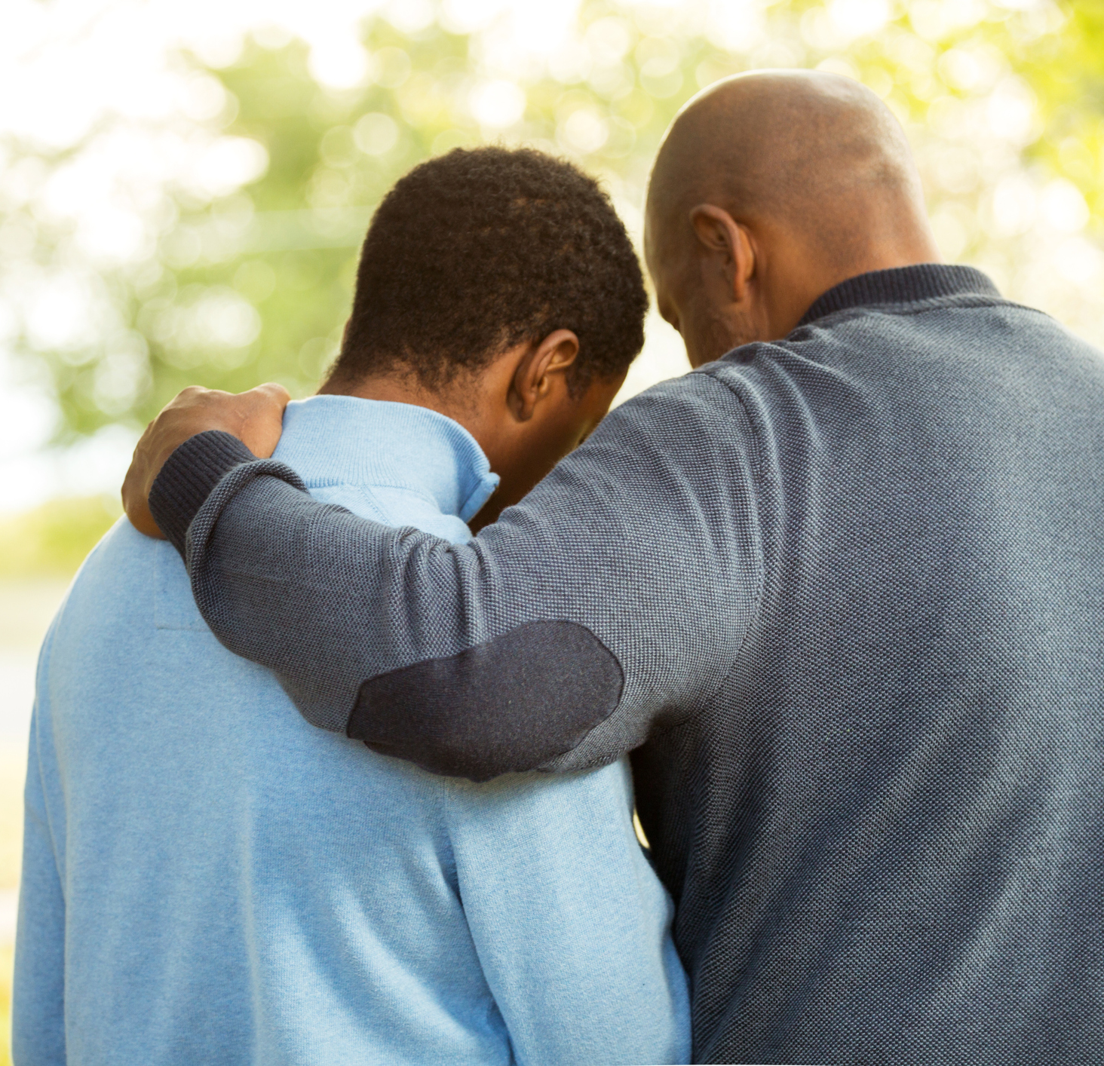
“You may aid [your children] to develop characters that will not be swayed or influenced to do evil, but will sway and influence others to do right.
By your fervent prayers of faith you can move the arm that moves the world.”
Ellen G. White, Adventist Home, 264

Slide 26
And behold, a certain lawyer stood up and tested Him, saying, “Teacher, what shall I do to inherit eternal life?” He said to him, “What is written in the law? What is your reading of it?” So he answered and said, “ ‘You shall love the Lord your God with all your heart, with all your soul, with all your strength, and with all your mind,’ and ‘your neighbour as yourself.’ ” And He said to him, “You have answered rightly; do this and you will live.”
Luke 10:25-28 (NKJV)

Slide 27
TRIBAL LAW
In an age that LOVES things and USES people, we are to LOVE people and USE things.

Slide 28
JESUS USED THINGS TO LOVE PEOPLE
He used mud to love a blind man,
He used sand to love an adulteress,
He used water and clay pots to love some newlyweds,
He used loaves and fish to love a crowd of hungry people,
He used his garment to love a bleeding woman,
and finally, He used a cross and three nails
to build a bridge of love.

Slide 29
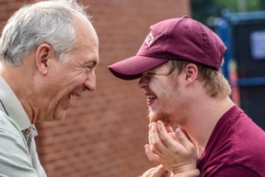
The greatest thing we will ever learn, is just to love like God loves, and to be loved in return.

Slide 30
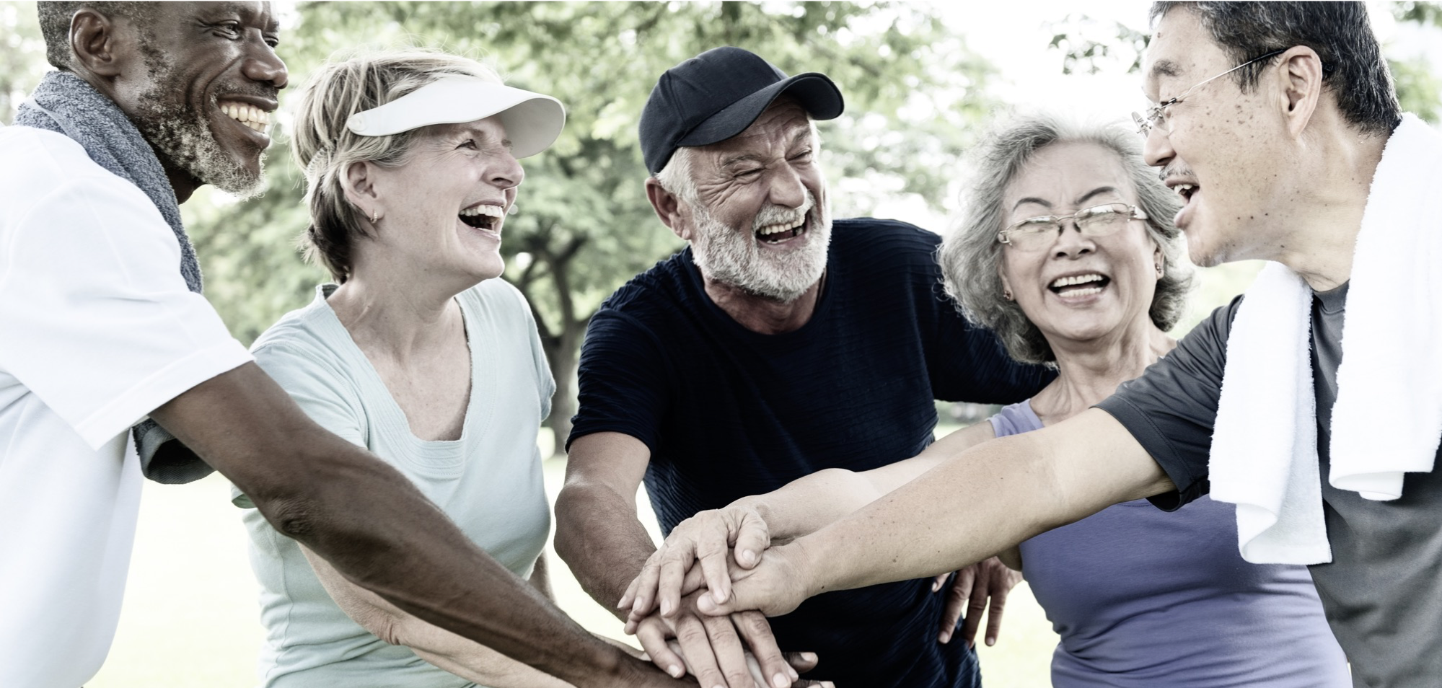
Q. How to be faithful with my Tribe?
A. A faithful steward does what their Master would do if He were present.
See Counsels on Stewardship, p. 113

