Slide 1
The 8 T’s of Grateful Living POWERPOINT INSTRUCTIONS (Delete this slide before presenting! ☺)
All the work is done! ☺
These slides are simply a helpful guide to get you started on the 8 T’s of Grateful Living theme. You can add, delete or edit them to suit your personal message.
REMEMBER to download the correct Sermon Script (it’s editable too), from the Grateful Living website, because it gives a suggested script for each slide.
To insert a New Slide. Select New Slide or Layout and select from the 25 x slide templates.* Then simply insert your own text and images onto the slides.
*If you would like to edit the 25 Master templates or make additional slide templates you will need to do the following: Select View > Master > Slide Master.
You can then duplicate a slide layout and make the changes you want.
When you're done, simply select Close Master View.

Slide 2
Why should we encourage Grateful Living? (Delete this slide before presenting! ☺)
Because an ‘attitude of gratitude’ is good for us, and it’s God will! (1 Thess. 5:16-18; Prov. 17:22; Eph. 5:20; 2 Cor. 4:15)
This series of Grateful Living messages falls under the category of what we often call ‘stewardship’—managing the things that God gives us—but for many listeners these messages will open up a whole new way of living abundantly (John 10:10).
You see, it’s simple, yet profound. God is love, and because he loves he gives (see John 3:16). God calls us to be faithful stewards of His love by loving Him and giving His love to others. We do this by sharing all that we have and are.
The very heart and foundation of stewardship isn’t money, it’s love.
At it’s very essence, Faithful Stewardship = Loving God and people with all we have and all we are. We are to love God and people with everything, with our 8 T’s—Time, Talents Testimony, Temple, Treasure, Territory, Tribe and God’s Truth.
In the book Counsels on Stewardship by Ellen G. White, the word ‘love’ is used 36 times in just the first 18 pages! Love is the foundation of stewardship.
When we understand God’s love we live gratefully. Grateful Living is about whole-of-life giving. God gives to us so that we can give to others. “And God is able to make all grace abound to you, so that in all things at all times having all that you need you will abound in every good work.” (2 Corinthians 9:8)
The gospel calls for a whole new way of living, grateful living, and it places love at the centre. When we love like God loves, “when we love the world as He has loved it, then for us His mission is accomplished. We are fitted for heaven; for we have heaven in our hearts.” (Ellen G. White, The Desire of Ages, p. 641)
So, is this 8 Pillars of Grateful Living really a stewardship series? Yes, because grateful living leads to cheerful giving, not only more faithful tithing and generous, systematic offerings, but whole-of-life giving, and that’s what God invites us to experience.
Welcome! to a whole new level of Christ-centred abundant living.

Slide 3
Grateful Living Topic: TRUTH Message Overview (Delete this slide before presenting! ☺)
Key Scriptures: Ephesians 4:14-15; John 8:32, 14:6, 17:17; 2 Tim. 2:15
Key EGW Writings: ‘The Truth as it is in Jesus’ 1 Selected Messages, pp. 311-319
Goal: Protecting and sharing God’s truth, in love.
Interview Idea: Is there an inspiring person in your church or wider community who you can interview (maybe even by phone or Zoom), about how they have been blessed by protecting and sharing God’s truth in love?

Slide 4
The slides for the actual presentation start on slide #5. (Delete this slide before presenting! ☺)

Slide 6
The 2-minute video called
Grateful Living Introduction
can be inserted and/or shown here.
The video can be downloaded at https://stewardship.adventistchurch.com/grateful-living/
Or simply delete this slide if you’re not showing the video.

Slide 8
Music: Anna Beaden & Kemy Ogendi

Slide 11

God’s Blueprint
Satan’s Counterfeit
God is the truth and He revealed His Truth in Jesus.
God’s word is truth.
Protecting the truth is important for the future salvation of people.
God calls me to share His truth in love because it reveals His true character.
Satan has been trying to destroy God’s truth for thousands of years.
There is no such thing as absolute truth.
Truth is a relative term, so each person can have their own truth.
Another person’s truth is no less true than the truth that I have from God.
Truth is less important than feelings.
All the great truths of the world will lead us to the same god.

Slide 12
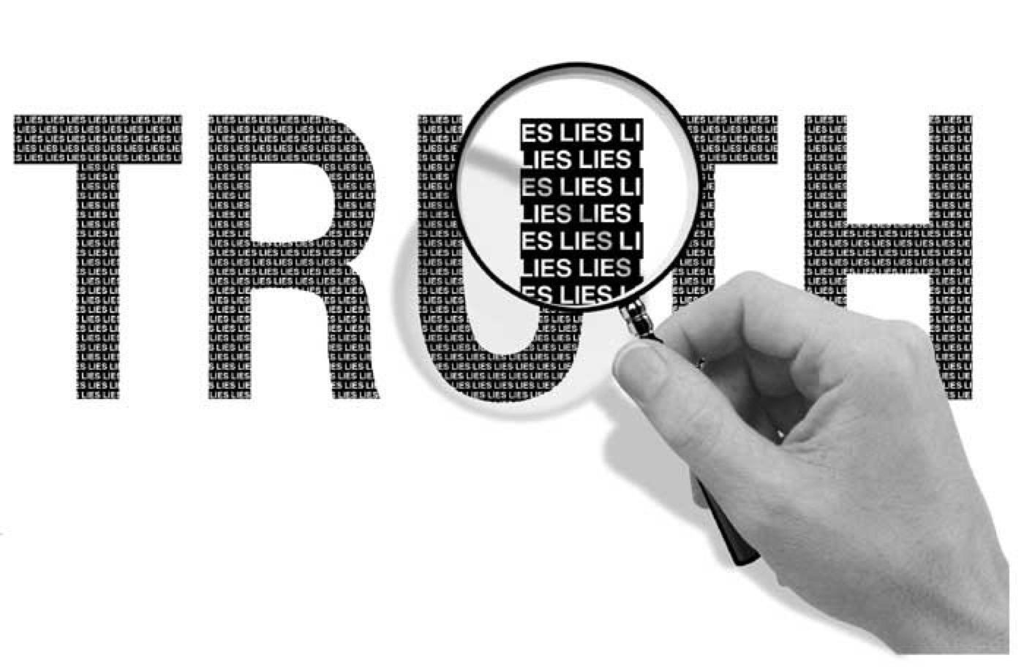

Slide 13

In a world filled with photoshopped images, fake news and deepfake videos how can we know what’s true?

Slide 14

TRUTH is TRUTH
even if no one believes it,
a LIE is a LIE
even if everyone believes it.

Slide 15
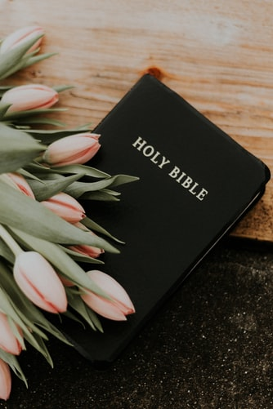
STEWARDS OF TRUTH
“Let a man so consider us, as servants of Christ and stewards of the mysteries of God. Moreover it is required in stewards that one be found faithful.”
1 Corinthians 4:1-2 (NKJV)

Slide 16
“Sanctify them by Your truth. Your word is truth.”
John 17: 17 (NKJV)

Slide 17
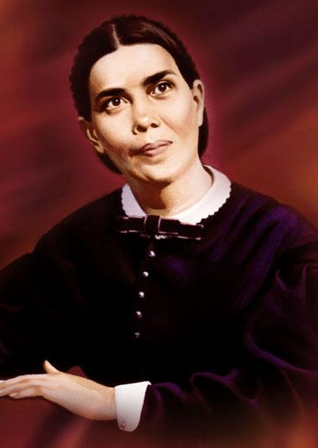
“There are many precious truths contained in the Word of God, but it is "present truth" that the flock needs now. I have seen the danger of the messengers running off from the important points of present truth, to dwell upon subjects that are not calculated to unite the flock and sanctify the soul. Satan will here take every possible advantage to injure the cause.”
Ellen G. White, Early Writings, 64

Slide 18
PRESENT TRUTH
is not always
PLEASANT TRUTH

Slide 19
TRUTH IN LOVE
“He who is the truth has made it possible for His servants, even in controversy, to make it manifest that the Spirit of truth is dwelling within them. … If the manner and words of the speaker are under the influence of the Spirit of God, self will be hid in Christ. … The truth is to be presented as it is in Jesus. Speak the truth in love. Let it be manifest that the love of Christ is in the heart, expressed in the countenance and in the words.”
Ellen G. White, Letter 9, para 9, 1894

Slide 20
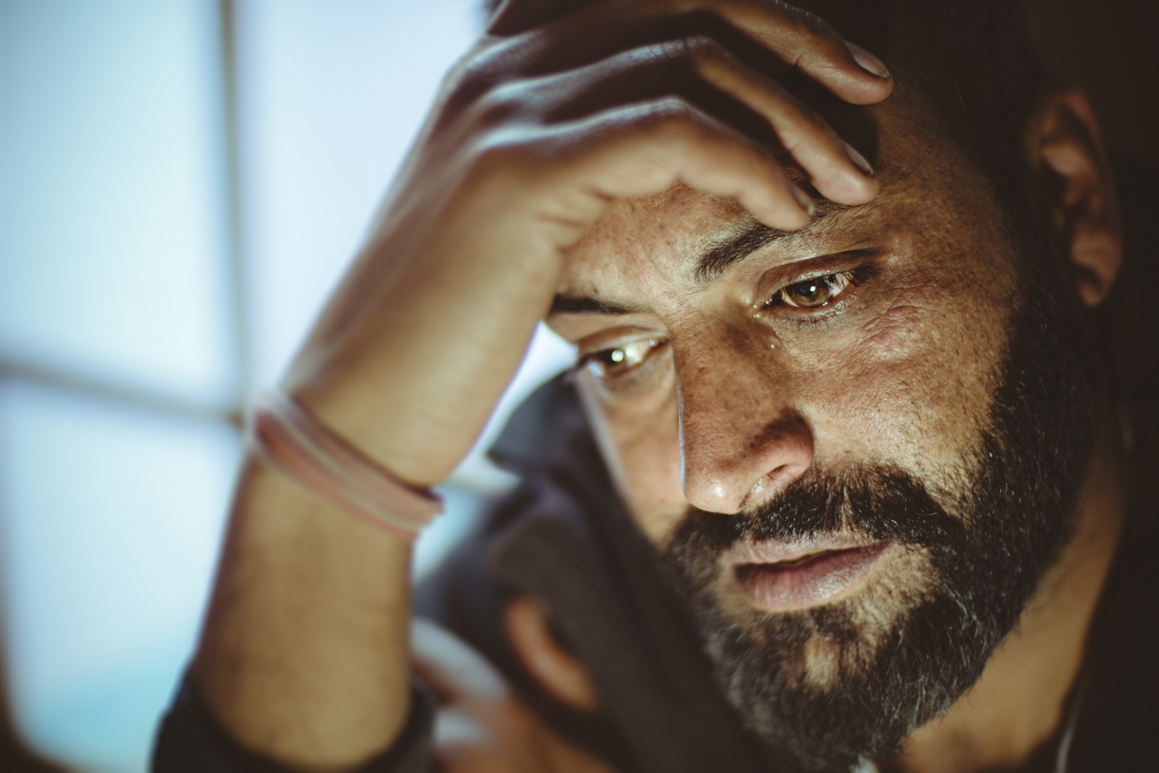
Share God’s truth in love, because the truth may hurt for a little while, but a lie can hurt forever.

Slide 21
“None but those who have fortified the mind with the truths of the Bible will stand through the last great conflict. To every soul will come the searching test: Shall I obey God rather than men? The decisive hour is even now at hand. Are our feet planted on the rock of God's immutable word? Are we prepared to stand firm in defense of the commandments of God and the faith of Jesus?”
Ellen G. White, The Great Controversy, 593

Slide 22
“Jesus said to him, “I am the way, the truth, and the life. No one comes to the Father except through Me.”
John 14:6 (NKJV)

Slide 23
“Be diligent to present yourself approved to God, a worker who does not need to be ashamed, rightly dividing the word of truth.”
2 Timothy 2:15 (NKJV)

Slide 24
EVERY WIND OF DOCTRINE
“In the days of the apostles the most foolish heresies were presented as truth. History has been and will be repeated. There will always be those who, though apparently conscientious, will grasp at the shadow, preferring it to the substance. They take error in the place of truth, because error is clothed with a new garment, which they think covers something wonderful. But let the covering be removed, and nothingness appears.”
Ellen G. White
The Review and Herald, February 5, 1901

Slide 25
“We should no longer be children, tossed to and fro and carried about with every wind of doctrine, by the trickery of men, in the cunning craftiness of deceitful plotting, but, speaking the truth in love, may grow up in all things into Him who is the head—Christ.”
Ephesians 4:14-15 (NKJV)

Slide 26
“You shall know the truth, and the truth shall make you free.”
John 8:32 (NKJV)

Slide 27
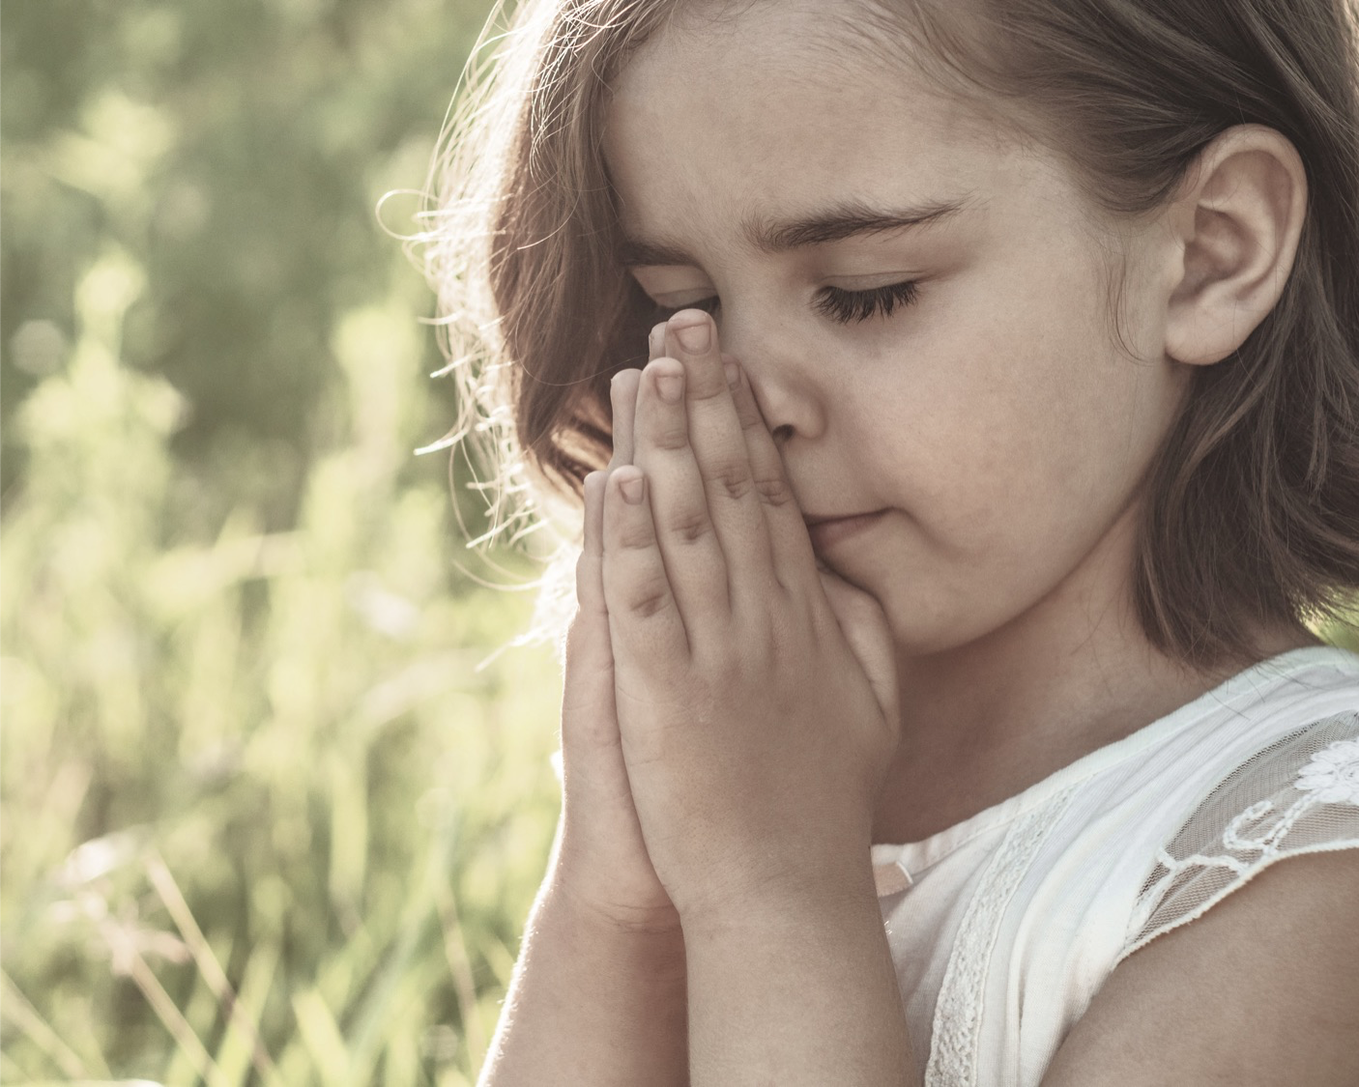
Q. How to be faithful with the Truth?
A. A faithful steward does what their Master would do if He were present.
See Counsels on Stewardship, p. 113

Slide 28
